Slide 1
Semiconductors 101, unit 1
What semiconductors and chips are
"Semiconductor" often means both a material and a whole industry. Start by sorting out the words people mix up most: semiconductor, wafer, chip and integrated circuit.
Semiconductors 101: a free course following the life of a chip
Free to use in class and for non-commercial teaching. Please credit fab24hr. Do not sell it or present it as your own work.
fab24hr.com/en/learn/chips/
fab24hr
Notes:
"Semiconductor" often means both a material and a whole industry. Start by sorting out the words people mix up most: semiconductor, wafer, chip and integrated circuit.

Slide 2
Semiconductors 101, unit 1
Goals
1 Explain how a semiconductor differs from a conductor and an insulator, and why being able to control whether it conducts matters so much.
2 Tell a wafer, a chip and an integrated circuit apart, and name the kinds of companies that share the work in "the chip industry".
3 Outline the three stages a chip goes through: design, manufacturing in a fab, and assembly and test.
fab24hr.com/en/learn/chips/
fab24hr

Slide 3
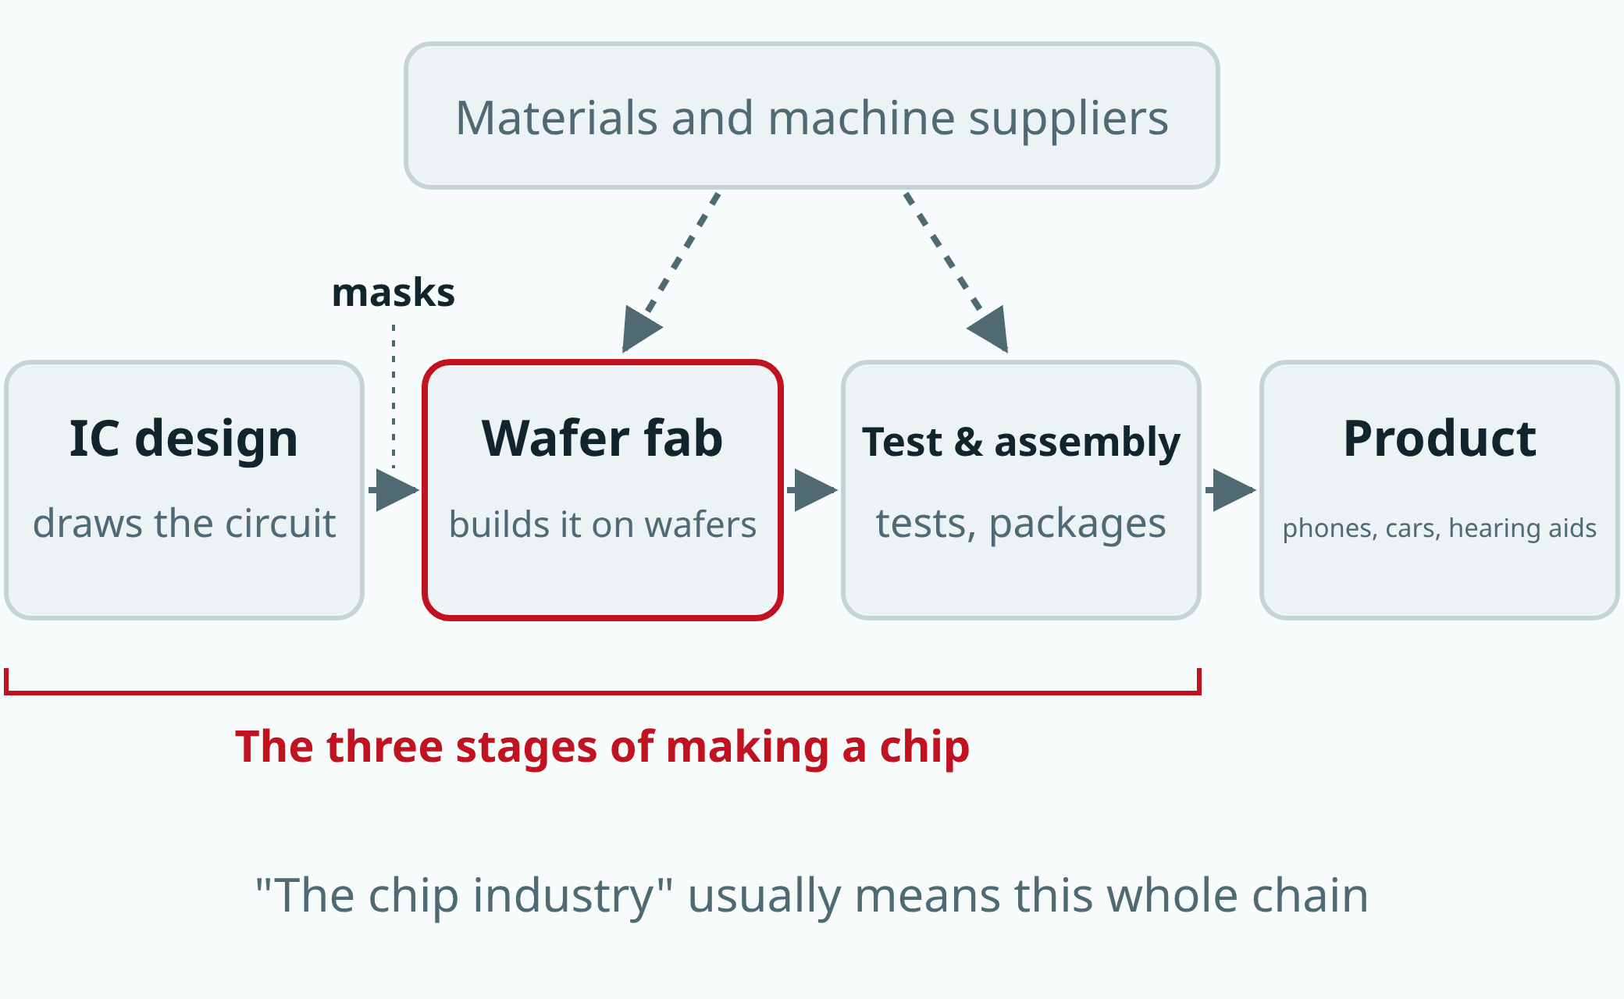
Semiconductors 101, unit 1
A chip is made in roughly three stages, often by different companies. Other companies supply the materials and the machines.
fab24hr.com/en/learn/chips/
fab24hr
Notes:
How a chip is shared out: an IC design company draws the circuit, which is made into photomasks for a wafer fab, the fab builds it on wafers, a test-and-assembly house tests and packages it, and it goes into a product; suppliers provide materials and machines to the fab and the test-and-assembly house.

Slide 4
Semiconductors 101, unit 1 · Key ideas 1/4
A semiconductor's conduction can be changed
Think of electricity as water in a pipe. A conductor is a pipe that's always open, like the copper inside a power cord. An insulator is a pipe that's blocked, like the plastic around the cord. A semiconductor is like a pipe that lets only a trickle through: on its own it conducts little, but adding a few atoms of another element, heating it, shining light on it or putting a voltage next to it changes how much gets through enormously; a transistor adds an electrically controlled gate on top. Its conduction falls between a conductor's and an insulator's, and the most common semiconductor is silicon.
fab24hr.com/en/learn/chips/
fab24hr

Slide 5
Semiconductors 101, unit 1 · Key ideas 2/4
Controlling conduction is what makes a switch
Adding a tiny amount of boron or phosphorus to very pure silicon on purpose is called doping: which atom you add, and how much, decides how that small region conducts and how well. A conductor is always on and an insulator always off, so neither can be switched by electricity alone, with no moving parts. A semiconductor can be on in one tiny region and off in the next, and it can be switched with electricity. A small switch built this way is a transistor, and one chip can hold hundreds of millions to more than ten billion of them. In circuits such as processors, the switches together decide whether each signal wire sits at a high voltage or a low one: high stands for 1, low for 0 (the common "on is 1, off is 0" isn't accurate: in logic, it is often a switch turning on and connecting a wire to ground that makes it 0).
fab24hr.com/en/learn/chips/
fab24hr

Slide 6
Semiconductors 101, unit 1 · Key ideas 3/4
The wafer is the whole sheet; a chip is one square
A chip is a small piece of silicon with many transistors and wires built on it, joined into one whole circuit. Its formal name is integrated circuit, or IC: "integrated" means the parts and wires are all made together on one piece instead of being soldered one by one. A wafer is the round slice of silicon chips are made on; copies of one design are laid out across it like a chessboard, dozens to more than ten thousand at once. Like a sheet of stamps, the wafer is tested and cut along the gaps, and only then do you get separate chips.
fab24hr.com/en/learn/chips/
fab24hr

Slide 7
Semiconductors 101, unit 1 · Key ideas 4/4
One chip passes through several kinds of companies
When the news says "semiconductors", it often means the whole industry that makes chips, not the material. A chip goes through three broad stages. A design company designs the circuit on computers, and the design is made into photomasks, the stencils used to print the circuit. A fab follows the masks and builds the chips on wafers layer by layer, over weeks to months. A test-and-assembly house tests every chip, cuts the wafer apart, packages each chip and tests it again. These stages are often done by different companies, and still others supply the materials and tools.
fab24hr.com/en/learn/chips/
fab24hr

Slide 8
Semiconductors 101, unit 1
Common misconceptions
People say: A "semi"conductor is something that conducts only half the electricity.
In fact: "Semi" says its conduction falls between a conductor's and an insulator's. It doesn't mean it conducts at half strength, or that it's on half the time. What makes it useful is that people can decide which tiny regions conduct, and how well.
People say: The little black square on a circuit board is the chip.
In fact: Strictly speaking, the black square is a packaged chip. The package protects the thin, brittle piece of silicon inside and brings its contacts to the outside; the real chip is in there. The small piece cut from the wafer before it is packaged is called a die.
fab24hr.com/en/learn/chips/
fab24hr

Slide 9

Semiconductors 101, unit 1
Play
Tap "Clock in" to start: choose "The life of a chip" to follow one chip all the way, or "A day in the fab" to work one shift as someone in the fab
Scan with a phone to play from here
fab24hr.com/en/?utm_source=slides
fab24hr.com/en/learn/chips/
fab24hr

Slide 10
Semiconductors 101, unit 1
Think
1 Which things around you contain chips? If the world had half as many chips tomorrow, where would your day get stuck first?
2 A chip is finished by several kinds of companies sharing the work, not by one company from start to finish. What does that division of labor gain, and what risks does it bring?
fab24hr.com/en/learn/chips/
fab24hr

Slide 11
Semiconductors 101, unit 1
Read
Semiconductors 101: what is a semiconductor, and what does a chip fab do?
fab24hr.com/en/blog/semiconductor-101/
What is a semiconductor, and why is it called "semi"?
fab24hr.com/en/blog/semiconductor/
What is a chip, and how is it different from a wafer, an IC or a semiconductor?
fab24hr.com/en/blog/what-is-a-chip/
fab24hr.com/en/learn/chips/
fab24hr

Slide 12
Semiconductors 101, unit 1
Semiconductors 101: a free course following the life of a chip
https://fab24hr.com/en/learn/chips/
Written from public textbooks, industry standards, university course notes and papers; the companies, people, machine numbers and figures in the game are fictional.
Free to use in class and for non-commercial teaching. Please credit fab24hr. Do not sell it or present it as your own work.
Generic illustration made with AI help from public sources; may contain mistakes; not any company’s tool
fab24hr.com/en/learn/chips/
fab24hr

