Slide 1
Semiconductors 101, unit 12
Etch: cutting the pattern in
Litho only prints the pattern onto the photoresist; the material underneath hasn't been touched yet. Etch is what really cuts the pattern into the wafer, and a mistake there is hard to undo.
Semiconductors 101: a free course following the life of a chip
Free to use in class and for non-commercial teaching. Please credit fab24hr. Do not sell it or present it as your own work.
fab24hr.com/en/learn/etching/
fab24hr
Notes:
Litho only prints the pattern onto the photoresist; the material underneath hasn't been touched yet. Etch is what really cuts the pattern into the wafer, and a mistake there is hard to undo.

Slide 2
Semiconductors 101, unit 12
Goals
1 Explain how etch relates to litho: how the resist works as a stencil, and why etch removes only what it doesn't cover.
2 Tell wet etching from dry etching, say what plasma is and why it cuts both straight and selectively, and what selectivity is.
3 Explain how a tool knows it has etched through, why it etches a little longer, what too little or too much does, and why the chamber needs watching every day.
fab24hr.com/en/learn/etching/
fab24hr

Slide 3
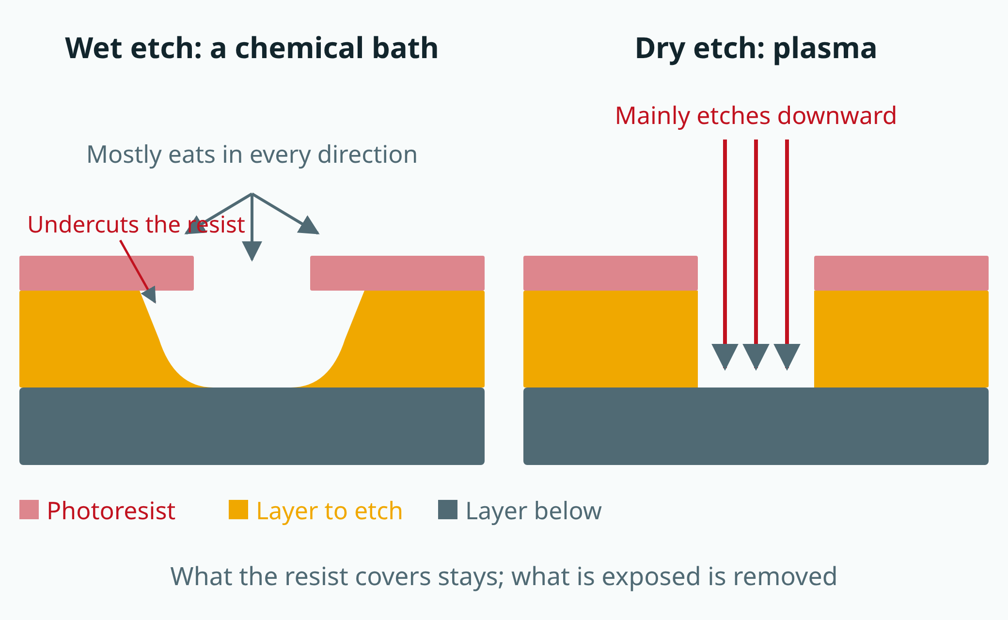
Semiconductors 101, unit 12
Fine patterns must be etched straight down, so they mostly use dry etching; wet etching uses simple equipment, is fast, and one bath can hold many wafers at once.
fab24hr.com/en/learn/etching/
fab24hr
Notes:
Left: wet etching, where the liquid eats in every direction and undercuts the resist, leaving rounded edges. Right: dry etching, where plasma etches mainly downward, leaving straight walls.

Slide 4
Semiconductors 101, unit 12 · Step by step 1/3
Step by step
1 Following the resist stencil, cut away the layer it doesn't cover.
Why: Litho only prints the pattern on the resist; the material below is untouched until etch cuts it in.
If not: If the cut line width strays too far from what it should be, this layer's pattern is wrong.
2 For fine patterns, skip the chemical bath and etch with plasma in a vacuum chamber.
Why: Chemicals have no sense of direction: they eat about as far sideways as down.
If not: When a line is about as wide as the film is thick, each side loses a thickness and most of the line, or all of it, is gone.
3 Bring the wafer into the chamber, hold it flat on the electrostatic chuck, and feed helium behind it.
Why: In a vacuum, suction can't hold the wafer and heat barely travels, so the plasma's heat has to pass through the helium to the cooled base below.
If not: The wafer gets hotter as it etches and the shape and line width drift; if too much helium leaks, the tool raises an alarm and stops, and a wafer may be stuck in the chamber halfway through.
fab24hr.com/en/learn/etching/
fab24hr

Slide 5
Semiconductors 101, unit 12 · Step by step 2/3
Step by step
4 Let the plasma's two forces cut together: chemical reaction plus a downward hit.
Why: The hits come from straight above and barely touch the side walls, and a thin film on the side walls shields them, so the cut is straight; the chemistry is choosier: the layer meant to go wears away fast, the rest slowly.
If not: If it isn't choosy enough (low selectivity: what should go and what should stay wear away at similar rates), the resist wears out before the end and a few extra seconds can cut right through.
5 Watch the plasma's light while etching; when it turns, the layer is cut through.
Why: The material being cut makes certain colors stronger; once the layer below shows, those colors fade.
If not: Without that sign, the layer may not be cut through, or the one below may be damaged.
6 After the turn, etch a little longer (over-etch).
Why: A film isn't equally thick everywhere and doesn't etch equally fast, and every hole has to reach the bottom.
If not: Too short and some holes don't open; too long and the layer below is damaged.
fab24hr.com/en/learn/etching/
fab24hr

Slide 6
Semiconductors 101, unit 12 · Step by step 3/3
Step by step
7 Keep the tool steady day to day: regular maintenance, a few season wafers and a qual run after cleaning, and line widths measured after etch to see if they slowly drift.
Why: What is etched off builds up on the chamber walls, so the same recipe slowly etches at a different speed.
If not: Finding out after a bad etch is too late: what was removed can't be put back, and in bad cases the wafer is scrapped.
fab24hr.com/en/learn/etching/
fab24hr

Slide 7
Semiconductors 101, unit 12 · What you adjust, what can go wrong 1/2
What you adjust, what can go wrong
Wet or dry
Changes: Wet soaks the wafer in chemicals: simple, fast, many wafers in one bath; dry uses plasma and cuts straight down.
If it is off: Use wet on a fine pattern and each side of a line loses about one film thickness, so most of the line is gone, or all of it.
Mix of chemistry and impact
Changes: Impact keeps the walls straight, and chemistry is pickier about materials; turning up the power supply under the wafer makes the ions hit harder, and raising the pressure gives chemistry a bigger part.
If it is off: Lean too much on impact and it stops being picky: the resist wears out before the end, and a few extra seconds can cut through the layer below. Lean too much on chemistry and it eats sideways, so the walls aren't straight.
Over-etch time
Changes: After the endpoint, etch a little longer so every hole reaches the bottom.
If it is off: Too short and some holes don't open; too long and the layer below is damaged.
fab24hr.com/en/learn/etching/
fab24hr

Slide 8
Semiconductors 101, unit 12 · What you adjust, what can go wrong 2/2
What you adjust, what can go wrong
Number of season wafers
Changes: After a chamber clean, wafers that aren't customer product run first to bring the walls back to a steady state.
If it is off: Too few, and the first wafers etch differently from usual.
How often to do PM
Changes: Opens the chamber regularly to clean off what builds up on the walls and replace worn parts.
If it is off: Too loose and the buildup flakes off as particles and the etch speed drifts; too conservative and the tool stops for PM it didn't need yet.
fab24hr.com/en/learn/etching/
fab24hr

Slide 9
Semiconductors 101, unit 12 · Key ideas 1/6
Litho prints, etch cuts, and fine patterns can't be soaked
Litho only prints the pattern onto the photoresist (a film that changes when light hits it); the material underneath hasn't been touched. Etch follows that stencil and removes the layer the resist doesn't cover, then the resist is stripped, and only then is the pattern really in the wafer. Many layers each go through this print-then-etch loop, so a wafer goes into the etcher many times before it is finished. The simplest way is wet etching: soak the wafer in chemicals. The equipment is simple and it's fast, but most chemicals have no sense of direction: they eat about as far sideways as down, and the edge comes out like a bowl scooped with a spoon. When a line is about as wide as the layer is thick, each side loses about one thickness, so most of the line is gone, or all of it. The finest lines today are only tens of nanometers wide or less, so fine patterns mostly go to dry etching, and wet etching is mostly used to remove whole layers or to clean.
fab24hr.com/en/learn/etching/
fab24hr

Slide 10
Semiconductors 101, unit 12 · Key ideas 2/6
What is plasma? Gas pulled apart by electricity
Dry etching uses plasma. Heat ice and it becomes water; heat water and it becomes steam. Give a gas even more energy and some molecules break into very reactive fragments, while others lose electrons and become positively charged ions. That is plasma, often called the "fourth state of matter"; the gas inside a lit fluorescent tube or neon sign is plasma. The etch tool brings the wafer into the chamber (a sealed space), holds it flat on an electrostatic chuck with helium on its back to carry heat away, pumps the chamber down to a very low pressure, feeds in gases such as ones containing fluorine or chlorine, and adds high-frequency power. In thin gas, an electron has room to speed up before it hits the next molecule, so it more easily builds up enough energy to break molecules apart. Often less than one percent of the gas actually becomes ions; the electrons move extremely fast, but electrons are very light, so the gas itself isn't hot and the reactions happen without baking the wafer. The helium behind the wafer carries away the heat the plasma brings to it during the etch.
fab24hr.com/en/learn/etching/
fab24hr

Slide 11
Semiconductors 101, unit 12 · Key ideas 3/6
Why plasma: fragments react, ions hit straight down
Plasma does two jobs at once. The fragments react with the exposed material and turn it into a gas that is pumped away. Electrons are light and fast, so they reach the wafer first and give its surface a negative charge, which draws in the positively charged ions; in a very thin layer just above the wafer the electric field points straight at the wafer, so the ions come down almost vertically. In a well-known experiment, etching silicon with only ions or only a reactive gas was slow, but both at once was several times faster. Ions only reach what is directly below them, so the bottom of a hole keeps getting hit while the side walls hardly do. The fragments have no direction and could eat into the side walls too, so the gas often includes something that grows a very thin protective film: at the bottom the constant hits keep the film from building up and the etch keeps going down, while on the side walls the film stays and blocks the fragments. Too little film and the walls get eaten; too much and the hole narrows as it goes. So the etch goes mostly downward and cuts straight, deep walls.
fab24hr.com/en/learn/etching/
fab24hr

Slide 12
Semiconductors 101, unit 12 · Key ideas 4/6
Where to stop: selectivity, endpoint detection and over-etch
Impact cuts straight but isn't very picky about materials; chemistry is pickier, and dry etching combines the two to get both straight and picky. The ratio between how fast the layer being cut and the material you want to keep are removed is called selectivity, like an eraser on a pencil mark: the pencil comes off fast, and the paper barely gets thinner. To know where to stop, many tools watch the plasma's light: the material being cut makes certain colors stronger, and once the layer below shows, those colors fade. This is endpoint detection. But a film isn't equally thick everywhere and doesn't etch equally fast, so the tool etches a while longer, called over-etch: with high selectivity the layer below loses only a little; with low selectivity a few extra seconds can cut right through.
fab24hr.com/en/learn/etching/
fab24hr

Slide 13
Semiconductors 101, unit 12 · Key ideas 5/6
A bad etch can't be undone, so the chamber is watched every day
Too little etching can sometimes be finished with more etching; too much damages the layer below, the material can't be put back, and in bad cases the wafer is scrapped. The tool doesn't know when the wrong settings were picked and runs them precisely, so for normal lots the system brings up the recipe (the settings the tool runs) and nobody picks it by hand. Yet the same recipe slowly starts to etch differently, because what is etched off builds up layer by layer on the chamber walls. So line width is measured after etch, each measured lot adds a point to a control chart, and several points in a row on the same side get looked into. After maintenance (PM) cleans the chamber, a few wafers that aren't customer product run to settle the walls (seasoning), and etch speed and particles are checked (a qual run) before the tool goes back to production.
fab24hr.com/en/learn/etching/
fab24hr

Slide 14
Semiconductors 101, unit 12 · Key ideas 6/6
Before and after: film thickness, waiting time and cleaning
How well an etch turns out also depends on the wafer it receives. If the film on one wafer is uneven, the thin spots break through first while the thick ones haven't, so the etch has to run longer; the bigger the difference, the more the layer under the thin spots can get damaged. If the film comes out a little thicker than usual and this etch step runs its usual fixed time instead of stopping at an endpoint, both steps are inside spec, yet some tiny holes don't quite reach the bottom, and the resistance of the contact between the transistor and the wiring above it goes up. Resist left too long after develop also makes the etched line width drift. After etch the resist is stripped, and etch residue and leftover resist must be cleaned off before the next step.
fab24hr.com/en/learn/etching/
fab24hr

Slide 15
Semiconductors 101, unit 12
Common misconceptions
People say: Etching just means dissolving material in acid.
In fact: That is wet etching, which also eats sideways and today is mostly used to remove whole layers or to clean. The fine patterns on a chip are mostly cut by dry etching, with plasma in a chamber pumped down close to a vacuum, which can cut straight, deep walls.
People say: If it's etched too far, you can fix it afterwards.
In fact: Only too little etching can sometimes be fixed, by etching more. Once it goes too far and damages the layer below, the material can't be put back, and in bad cases the wafer is scrapped. So the tool is kept steady all along: regular maintenance (PM), a few season wafers after cleaning, then a qual run, and line widths measured after etch and plotted on a control chart to catch a slow drift to one side.
fab24hr.com/en/learn/etching/
fab24hr

Slide 16
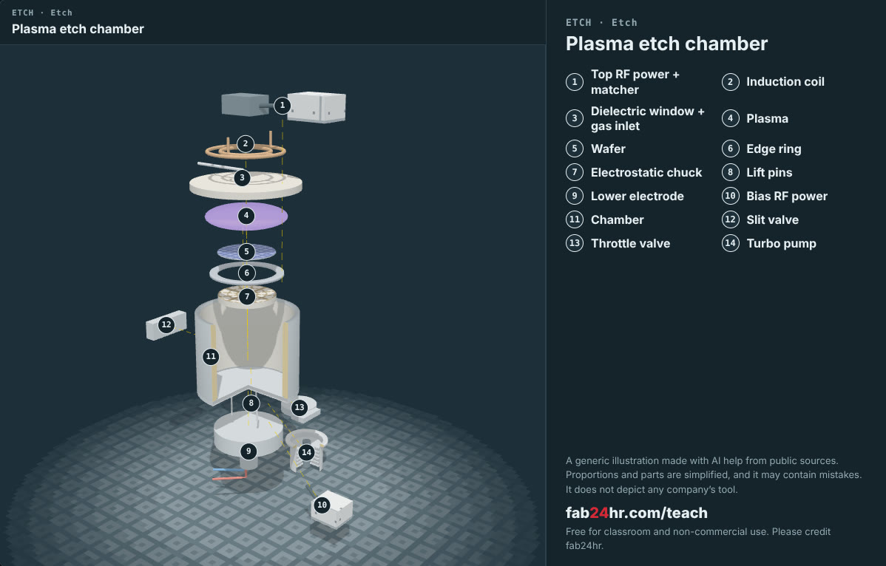
Semiconductors 101, unit 12 · Look: machines to take apart
fab24hr.com/en/learn/etching/
fab24hr
Notes:
Plasma etch chamber：https://fab24hr.com/en/?tool=etch

Slide 17

Semiconductors 101, unit 12
Play
Start at chapter 6, "The Call": the etcher stops in the middle of the night
Scan with a phone to play from here
fab24hr.com/en/?story=6&utm_source=slides
fab24hr.com/en/learn/etching/
fab24hr

Slide 18
Semiconductors 101, unit 12
Think
1 Endpoint detection says the layer is through, yet the tool keeps etching a little longer: too short and some holes don't open, too long and the layer below is damaged. If you had to set how long, what data would you look at first?
2 A tool fails at night with a wafer stuck inside, half etched. What does waiting for more information cost, and what does acting right away cost? (Think about it after playing chapter 6.)
fab24hr.com/en/learn/etching/
fab24hr

Slide 19
Semiconductors 101, unit 12
Read
What is etching? How are dry and wet etching different?
fab24hr.com/en/blog/what-is-etching/
What is plasma, and why do chip fabs etch with it?
fab24hr.com/en/blog/what-is-plasma/
fab24hr.com/en/learn/etching/
fab24hr

Slide 20
Semiconductors 101, unit 12
Semiconductors 101: a free course following the life of a chip
https://fab24hr.com/en/learn/etching/
Written from public textbooks, industry standards, university course notes and papers; the companies, people, machine numbers and figures in the game are fictional.
Free to use in class and for non-commercial teaching. Please credit fab24hr. Do not sell it or present it as your own work.
Generic illustration made with AI help from public sources; may contain mistakes; not any company’s tool
fab24hr.com/en/learn/etching/
fab24hr

