Slide 1
Semiconductors 101, unit 16
A factory that never stops
A fab never turns off the lights: wafers ride in sealed boxes along tracks in the ceiling, some steps cannot wait too long between them, and hot lots and machine maintenance all have to fit in.
Semiconductors 101: a free course following the life of a chip
Free to use in class and for non-commercial teaching. Please credit fab24hr. Do not sell it or present it as your own work.
fab24hr.com/en/learn/fab-operations/
fab24hr
Notes:
A fab never turns off the lights: wafers ride in sealed boxes along tracks in the ceiling, some steps cannot wait too long between them, and hot lots and machine maintenance all have to fit in.

Slide 2
Semiconductors 101, unit 16
Goals
1 Explain why a fab runs 24 hours a day, and what stopping would cost.
2 Describe how wafers move around a fab and how MES keeps track of where every lot is, and why one wafer takes months to finish.
3 Understand the trade-offs in scheduling: how hot lots, time limits between steps (Q-time) and maintenance affect each other.
fab24hr.com/en/learn/fab-operations/
fab24hr

Slide 3
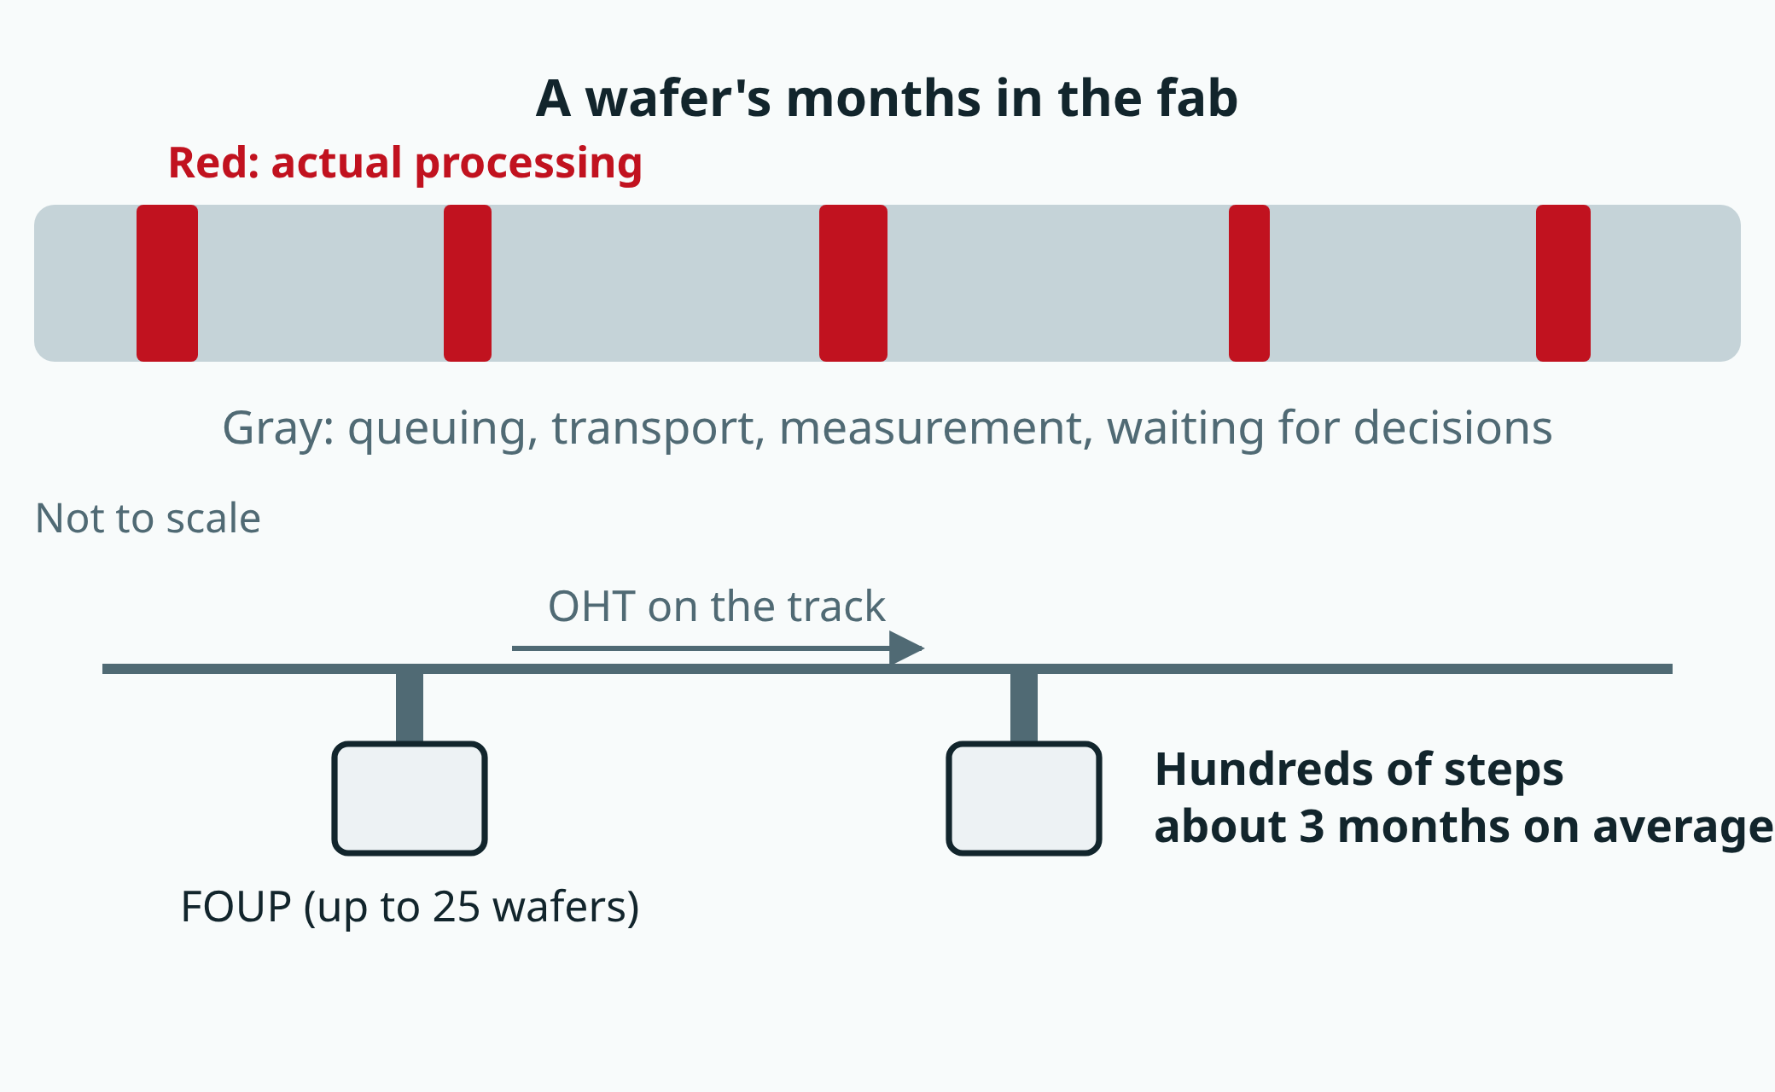
Semiconductors 101, unit 16
The proportions are illustrative. Wafers travel in sealed pods along tracks in the ceiling.
fab24hr.com/en/learn/fab-operations/
fab24hr
Notes:
A long bar standing for a wafer's months in the fab: only a few short sections are actual processing in a machine; most of the time is spent queuing for machines, waiting for transport and waiting for measurement. Below: a track in the ceiling, where an OHT lowers a FOUP (a sealed wafer pod) to a machine.

Slide 4
Semiconductors 101, unit 16 · Step by step 1/3
Step by step
1 Keep the tools running 24 hours a day, nights included.
Why: Tools are very expensive and depreciate every day; running 24 hours makes the depreciation per wafer about a third of running 8.
If not: Stop the line at night and every wafer takes longer to finish, so deliveries slip.
2 A common way: split people into four crews on 12-hour shifts in rotation.
Why: The fab needs people 24 hours a day without anyone working all the time.
If not: No one crew can cover 24 hours; shifts mean handovers, and with a poor handover the next shift can't pick up what the last one left.
3 Put wafers in a sealed FOUP and let the OHTs on the ceiling carry them.
Why: One invisible particle can break a line, and people are the biggest source of particles in a cleanroom.
If not: Carried by hand, a full box weighs about 7 to 9 kilograms, too much to lift many times a day, and boxes get mixed up or sent to the wrong tool.
fab24hr.com/en/learn/fab-operations/
fab24hr

Slide 5
Semiconductors 101, unit 16 · Step by step 2/3
Step by step
4 Let MES (the manufacturing execution system) track where every lot is, and before a lot goes into a tool, check the step, the tool, the recipe and Q-time.
Why: A tool doesn't know it has been given the wrong lot and will carry out the wrong conditions very precisely. MES also records which tool, chamber and recipe each wafer ran on and when, which is what tracing back relies on when something goes wrong.
If not: A lot at the wrong step or on the wrong recipe that isn't stopped may need rework or even scrap; without the records, everything from a whole stretch of time has to be stopped when something goes wrong.
5 Don't book the tools full; leave some slack.
Why: Wafers spend most of their time waiting, and the closer a tool is to never idle, the faster the queue grows.
If not: Book them full and one tool going down or one lot needing rework can jam the whole line.
6 Hot lots go first at every step, but keep them few.
Why: The waiting a hot lot skips doesn't vanish; the lots behind it take it on.
If not: If everything is a hot lot, hot lots queue behind each other, and it's as if there were none.
fab24hr.com/en/learn/fab-operations/
fab24hr

Slide 6
Semiconductors 101, unit 16 · Step by step 3/3
Step by step
7 Stop tools on schedule for maintenance, and test them before they take lots again.
Why: Deposits build up in the chamber and parts wear; before a tool breaks, what it makes may already be off.
If not: Putting it back together doesn't mean it's the same as before, and by the time measurement catches it, several lots may be done.
fab24hr.com/en/learn/fab-operations/
fab24hr

Slide 7
Semiconductors 101, unit 16 · Key ideas 1/4
Expensive tools, hard to restart
An ordinary factory can lock up at night, but a fab is running even at three in the morning. One reason is money: the tools are extremely expensive, and whether they are used or not, their value is spread out a little every day. This is called depreciation. Running 24 hours a day instead of 8 makes the depreciation carried by each wafer about a third as large. The other reason is that stopping is hard to undo: heating and cooling a high-temperature furnace over and over wears it out, and a chamber that works in a vacuum has to be pumped down again once it is opened. After any stop, a tool runs test wafers to confirm its results are normal before product goes back in.
fab24hr.com/en/learn/fab-operations/
fab24hr

Slide 8
Semiconductors 101, unit 16 · Key ideas 2/4
Wafers ride in sealed boxes along the ceiling, and MES knows where every lot is
Wafers move around the fab in a sealed box called a FOUP, up to 25 to a box, which keeps out particles too small to see but big enough to break a line on a chip; small vehicles on rails in the ceiling, called OHTs, stop right above a tool and lower the box straight down. People don't carry the boxes because a full one weighs 7 to 9 kilograms, people bring particles, and mistakes are easy to make. Where a lot goes next isn't left to memory either, since the wafers all look the same and nobody can tell whether a lot is on layer 3 or layer 30. The factory's computer system, MES (manufacturing execution system), keeps each lot's route and the step it is at now, and before a lot goes into a tool it checks that the lot belongs at this step, that the tool can run it, which recipe (the settings the tool follows) to use and whether Q-time (the time limit between steps) has run out; only when all of them are right does the lot go in. If a measurement falls outside its limits or Q-time runs out, the lot is put on hold in MES (kept where it is), and the system stops dispatching it.
fab24hr.com/en/learn/fab-operations/
fab24hr

Slide 9
Semiconductors 101, unit 16 · Key ideas 3/4
For months, wafers mostly wait in line
A wafer goes through hundreds of steps. From the day it goes onto the line (wafer start) until it is finished takes about three months on average, a figure often given in the industry, and this stretch is called cycle time. Think of a health checkup: each test takes a few minutes, yet you spend most of the morning in the hallway waiting to be called. A wafer, too, spends only a small share of its time being processed inside tools. The rest is waiting: for a tool, for transport, for measurement, for someone's decision. The fuller the tools are booked, the longer the lines.
fab24hr.com/en/learn/fab-operations/
fab24hr

Slide 10
Semiconductors 101, unit 16 · Key ideas 4/4
Dispatch: hot lots, Q-time and maintenance pull on each other
Which lot each tool runs next is usually left to the dispatch system: it reads the data in MES (where each lot is, how urgent it is, how much time it has left, and which tools can run right now) and follows its rules to pick the next lot for each tool; with out-of-date data, a lot can be sent to a tool that has already stopped. In that scheduling, three things compete for tool time. Q-time is the limit on how soon the next step must start after one step finishes, because a wafer surface left too long changes. A hot lot usually goes first at every step, but the waiting it skips is waiting other lots take on. Maintenance (PM) means stopping a tool on schedule, before it breaks, to clean it and replace parts. While a tool is stopped, the countdowns keep running, so scheduling starts with who can wait least: if the hot lot will still make its deadline, the lot about to run out of time goes first.
fab24hr.com/en/learn/fab-operations/
fab24hr

Slide 11
Semiconductors 101, unit 16
Common misconceptions
People say: A fab runs 24 hours a day so that every tool can be booked completely full.
In fact: Fabs usually don't book their busiest tools to 100%. As at a checkout, the closer the cashier gets to never being free, the faster the line grows. With tools booked too full, waiting time shoots up, and one tool going down or one lot needing rework can jam the whole line. Running 24 hours is about keeping wafers moving.
People say: If a tool isn't broken, there's no need to stop it.
In fact: Deposits slowly build up inside the chamber and parts wear out, so even before a tool breaks, the wafers it makes may already be drifting off. Stopping on schedule for maintenance means people, parts and time are ready in advance. Waiting for a breakdown often means repairs in the middle of the night or when the line is busiest, for a length of time nobody can predict.
fab24hr.com/en/learn/fab-operations/
fab24hr

Slide 12
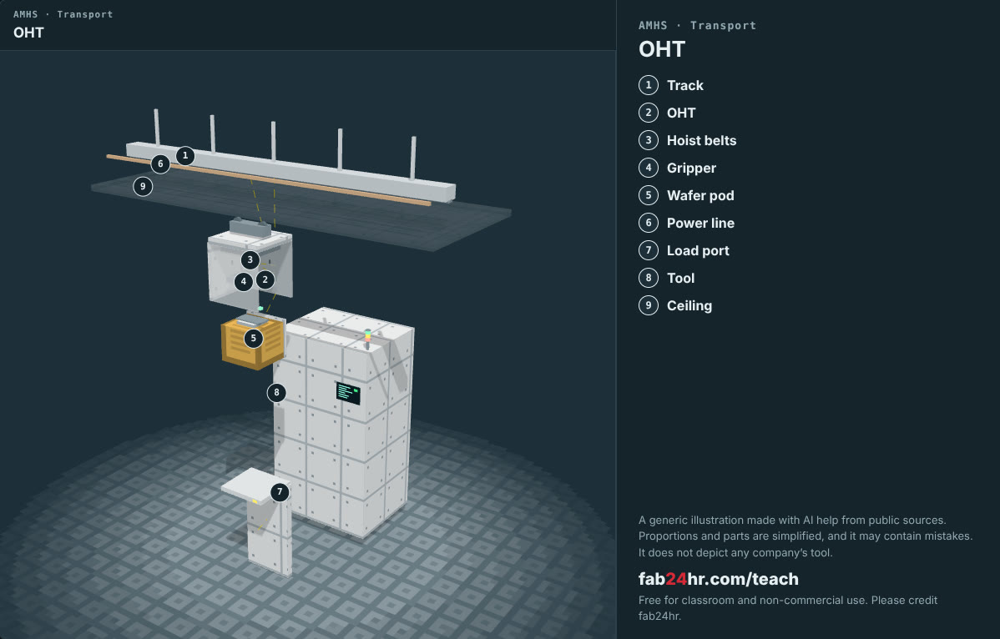
Semiconductors 101, unit 16 · Look: machines to take apart
fab24hr.com/en/learn/fab-operations/
fab24hr
Notes:
OHT：https://fab24hr.com/en/?tool=oht

Slide 13
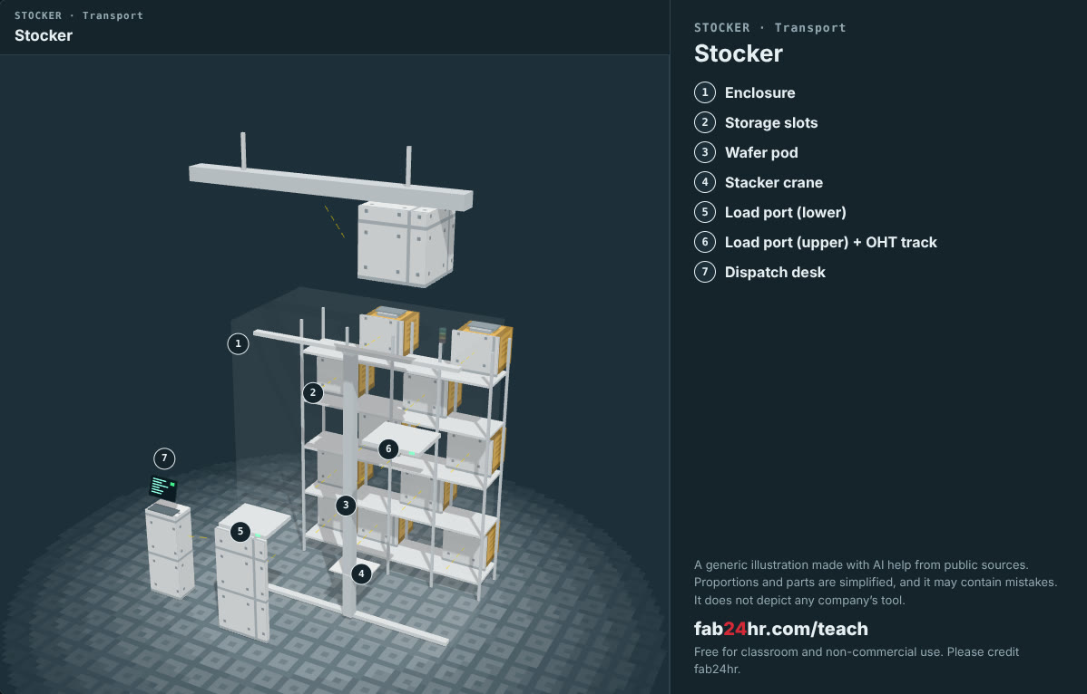
Semiconductors 101, unit 16 · Look: machines to take apart
fab24hr.com/en/learn/fab-operations/
fab24hr
Notes:
stocker：https://fab24hr.com/en/?tool=stocker

Slide 14

Semiconductors 101, unit 16
Play
Play a shift in Manufacturing: keeping a whole area's lots moving
Scan with a phone to play from here
fab24hr.com/en/?job=mfg&utm_source=slides
fab24hr.com/en/learn/fab-operations/
fab24hr

Slide 15
Semiconductors 101, unit 16
Think
1 Shift work keeps the factory running, but people need sleep. How should a factory that never stops look after the people who work in it?
2 When a hot lot jumps the queue, the lots in front have to wait. Should hot lots always go first? Who decides, and on what basis?
fab24hr.com/en/learn/fab-operations/
fab24hr

Slide 16
Semiconductors 101, unit 16
Read
Why do chip fabs run 24 hours a day?
fab24hr.com/en/blog/fab-never-stops/
How do wafers move around a fab? FOUPs and the overhead hoist transport
fab24hr.com/en/blog/foup-and-amhs/
What is MES, and how does a chip fab know where every lot of wafers is?
fab24hr.com/en/blog/what-is-mes/
How long does a wafer take to make, and why does cycle time run to months?
fab24hr.com/en/blog/cycle-time/
Further
What is a hot lot, and why doesn't it always go first?
What do the red, yellow and green lights on a tool mean?
fab24hr.com/en/learn/fab-operations/
fab24hr

Slide 17
Semiconductors 101, unit 16
Semiconductors 101: a free course following the life of a chip
https://fab24hr.com/en/learn/fab-operations/
Written from public textbooks, industry standards, university course notes and papers; the companies, people, machine numbers and figures in the game are fictional.
Free to use in class and for non-commercial teaching. Please credit fab24hr. Do not sell it or present it as your own work.
Generic illustration made with AI help from public sources; may contain mistakes; not any company’s tool
fab24hr.com/en/learn/fab-operations/
fab24hr

