Slide 1
Semiconductors 101, unit 3
The supply chain: who does what, and how they work together
On its way from materials, design, masks and the wafer fab through assembly and test to the inside of a phone, a chip often passes through several companies. First see what each stop does and why it is often a different company, then follow one order from choosing a process to the wafers arriving at the test-and-assembly house.
Semiconductors 101: a free course following the life of a chip
Free to use in class and for non-commercial teaching. Please credit fab24hr. Do not sell it or present it as your own work.
fab24hr.com/en/learn/industry/
fab24hr
Notes:
On its way from materials, design, masks and the wafer fab through assembly and test to the inside of a phone, a chip often passes through several companies. First see what each stop does and why it is often a different company, then follow one order from choosing a process to the wafers arriving at the test-and-assembly house.

Slide 2
Semiconductors 101, unit 3
Goals
1 Say what each stop on the supply chain does and why it is often a different company, and tell which way of slicing the chain a news story means by upstream, midstream and downstream.
2 Tell fabless design companies, foundries, IDMs and test-and-assembly houses apart, say why the work is split this way, and why one broken link slows the whole chain.
3 Walk through each step a design company takes, from choosing a process, tape-out, masks and wafer start to the test-and-assembly house, and say why a new product often shares a ride first and starts with engineering lots.
fab24hr.com/en/learn/industry/
fab24hr

Slide 3
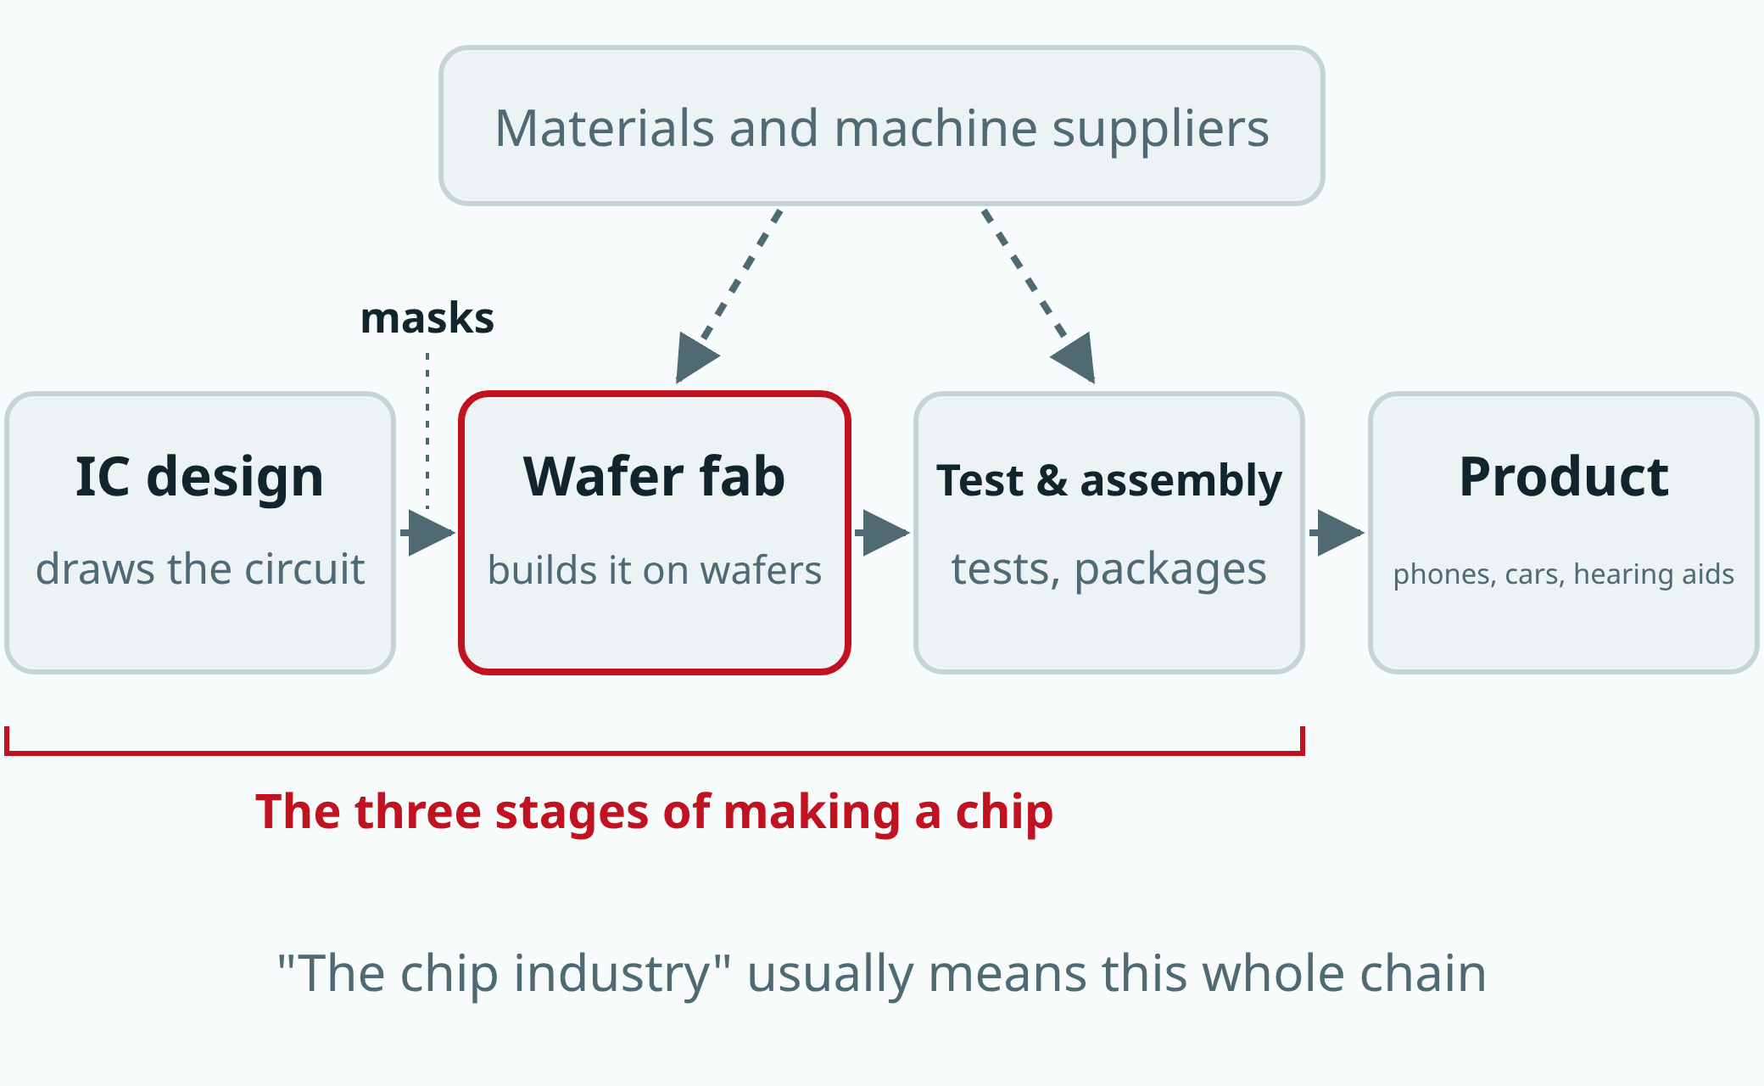
Semiconductors 101, unit 3
A chip is made in roughly three stages, often by different companies. Other companies supply the materials and the machines.
fab24hr.com/en/learn/industry/
fab24hr
Notes:
How a chip is shared out: an IC design company draws the circuit, which is made into photomasks for a wafer fab, the fab builds it on wafers, a test-and-assembly house tests and packages it, and it goes into a product; suppliers provide materials and machines to the fab and the test-and-assembly house.

Slide 4
Semiconductors 101, unit 3 · Step by step 1/3
Step by step
1 Choose a foundry and a process generation, and get the design rules and the transistor models.
Why: Transistors come out differently at every foundry and in every generation, so the design has to be drawn for what this fab can make.
If not: With the wrong rules, the design fails its checks; with the wrong models, the chip's speed and power use come out far from what the computer predicted.
2 Agree roughly when the design will tape out, how many wafers go in first, and how many a month after that.
Why: A wafer takes months to make and the tools are often fully booked, so the foundry has to hold the slots in advance.
If not: The design is finished but can't get in, so it waits; and if the product sells well, there's no way to make more.
3 Tape out: once every check has passed, hand the files with every layer's shapes to the foundry.
Why: The next step, making masks, is expensive and slow, so mistakes have to be caught here; that's why the foundry checks the files again when they arrive.
If not: A mistake found only after the wafers are made costs money and several months.
fab24hr.com/en/learn/industry/
fab24hr

Slide 5
Semiconductors 101, unit 3 · Step by step 2/3
Step by step
4 Correct the patterns for the finest layers by computer first, then make each layer into a photomask and inspect it.
Why: The pattern is printed onto the wafer with light shining through the mask, just as printing needs a plate first.
If not: One defect missed on a mask gets printed onto every wafer.
5 Once the masks arrive, start the wafers: they go station by station through hundreds of steps, about three months on average, as the industry often says.
Why: A chip has dozens of layers, each printed, etched, given a new film and measured, and most of the time the wafers wait in line for tools.
If not: Start a week late and you ship a week late; the only way to go faster is to wait less in line, not to skip a step.
6 When the wafers are done, measure WAT on small structures left between the chips for measuring, and send the numbers to the customer with the wafers.
Why: They show the lot was made with the agreed process and matches the models the customer designed with.
If not: If the lot drifted and nobody noticed, it gets tested, cut and packaged anyway, and the money and time are wasted.
fab24hr.com/en/learn/industry/
fab24hr

Slide 6
Semiconductors 101, unit 3 · Step by step 3/3
Step by step
7 Send the wafers to the test-and-assembly house: test every chip first, then cut them apart, package them and test them again.
Why: The chips are still joined together on the wafer and have no package, so they can't be soldered onto a circuit board yet.
If not: Bad chips that weren't caught get packaged with the good ones, which costs more and may even reach the customer.
fab24hr.com/en/learn/industry/
fab24hr

Slide 7
Semiconductors 101, unit 3 · Key ideas 1/4
A chip moves down one chain, and each stop is often a different company
The supply chain is the long line of companies a chip passes through on its way from nothing to a finished product: suppliers of materials and tools, design software and semiconductor IP (circuit blocks someone else designed, bought and dropped into the chip), chip design, the mask shop, the wafer fab, the test-and-assembly house, and finally the assembly plant that solders the chip onto a circuit board and builds it into a product. Each stop needs very different money and know-how: design spends mostly on people and software, and the wafer fab costs the most; making a gas extremely pure or building a scanner is a specialty in its own right. A company that does one stage and sells to many customers can spread the cost. The news slices the chain into upstream, midstream and downstream in two common ways: one looks only at the three stages of making a chip, design, fabrication, and assembly and test; the other counts materials, tools and design software as upstream, all three chip-making stages as midstream, and putting chips into products as downstream. When you see "upstream", check which one the writer means: it could be a design company, or a materials supplier.
fab24hr.com/en/learn/industry/
fab24hr

Slide 8
Semiconductors 101, unit 3 · Key ideas 2/4
Four kinds of company, told apart by which stages they do
An IDM (integrated device manufacturer) designs its own chips and has its own fab. A fabless design company ("fabless" means without a fab) only designs and has others make the chips. A foundry only makes chips other companies designed and sells none of its own. A test-and-assembly house (OSAT) does packaging and testing. Think of printing a book: the design company is the publisher, the foundry is the printer that prints each customer's manuscript, the test-and-assembly house is the bindery, and an IDM is a publisher with its own printing plant. These names are more like roles: one company often plays more than one.
fab24hr.com/en/learn/industry/
fab24hr

Slide 9
Semiconductors 101, unit 3 · Key ideas 3/4
Why split the work among so many companies, and what happens when a link breaks?
Mostly because a fab is very expensive: it takes a building and many costly tools, and years to build; once bought, the tools lose value every day whether they run or not, so the busier the tools, the better a fab pays, and fabs try to stay fully booked. One company's chips often can't fill a fab; a foundry pools orders from many companies so its tools always have work, and a small company with only a design team can still get its chips made. The price is that the chain runs one stage after another: if one stage hasn't delivered, the next has nothing to work on, and the slowest stage decides when the product is done. A broken link is also hard to fix fast: a new material, tool or test-and-assembly house has to be tried in small runs first to confirm the results come out the same, a wafer takes weeks to months from wafer start to finish, and a new fab takes years.
fab24hr.com/en/learn/industry/
fab24hr

Slide 10
Semiconductors 101, unit 3 · Key ideas 4/4
The first time: share a ride, try it out, then go to production
Making a whole mask set just for a few sample chips is too expensive, so a first try often uses a multi-project wafer (MPW), also called a shuttle: designs from several companies are squeezed onto one mask set and made on one batch of wafers, sharing the cost, but it leaves on fixed dates and only a limited number of chips come back. Even with its own mask set, a product's first few lots are usually engineering lots (also often called the pilot run), made to try things out and find problems, often with some wafers deliberately made so their transistors come out a little faster or slower than normal (the corners), to see whether the design holds up; a production lot follows a locked standard process, and every lot is made the same way. Before moving to production there are usually a few gates: yield is steady enough, the reliability tests have passed, and the customer has signed off; starting production lots before the reliability tests have finished is called a risk start. Later, if the foundry wants to change its process in a way that affects the customer, it has to formally tell the customer first.
fab24hr.com/en/learn/industry/
fab24hr

Slide 11
Semiconductors 101, unit 3
Common misconceptions
People say: Whichever company's name is on the chip is the company that made it.
In fact: The part number on the case belongs to the company that sells the chip. A fabless company's chip is usually made by a foundry and packaged and tested by a test-and-assembly house, yet it still carries the design company's part number. When reading the news, instead of asking "which kind of company is this?", ask "for this chip, who did which stage?"
People say: When the news says a new chip "has taped out" or "has started production at a foundry", the chips are already made.
In fact: Not yet. Tape-out means the design has been handed over and the masks are about to be made; nobody has chips yet. Starting production means the wafers are being made, which takes months, and testing and packaging still come after. Even "samples are shipping" only means some chips are being sent to the companies that will buy them, to try out and check; it isn't volume shipping yet. From tape-out to chips in hand often takes several months.
fab24hr.com/en/learn/industry/
fab24hr

Slide 12

Semiconductors 101, unit 3
Play
Start at chapter 4, "Two Weeks Early": the reliability test still has three weeks to run, the customer wants a risk start, and you give your recommendation
Scan with a phone to play from here
fab24hr.com/en/?story=4&utm_source=slides
fab24hr.com/en/learn/industry/
fab24hr

Slide 13
Semiconductors 101, unit 3
Think
1 A foundry often makes chips for several competing companies at once. If you ran a small design company, what would you want to ask before handing over your most valuable asset, the design?
2 For a first chip, you can share a ride on a multi-project wafer (MPW), or make your own full mask set right away. If it were your call, what would you look at, and what does each choice cost you?
fab24hr.com/en/learn/industry/
fab24hr

Slide 14
Semiconductors 101, unit 3
Read
What does each part of the semiconductor supply chain do?
fab24hr.com/en/blog/supply-chain/
The news says "fabless", "foundry" and "IDM". What's the difference?
fab24hr.com/en/blog/fabless-vs-idm/
The news says "foundry". What is it, and how does making chips for other companies work as a business?
fab24hr.com/en/blog/what-is-foundry/
How does a chip design company work with a foundry, from order to delivery?
fab24hr.com/en/blog/foundry-order/
Further
Why are chips so expensive?
fab24hr.com/en/learn/industry/
fab24hr

Slide 15
Semiconductors 101, unit 3
Semiconductors 101: a free course following the life of a chip
https://fab24hr.com/en/learn/industry/
Written from public textbooks, industry standards, university course notes and papers; the companies, people, machine numbers and figures in the game are fictional.
Free to use in class and for non-commercial teaching. Please credit fab24hr. Do not sell it or present it as your own work.
Generic illustration made with AI help from public sources; may contain mistakes; not any company’s tool
fab24hr.com/en/learn/industry/
fab24hr

