Slide 1
Semiconductors 101, unit 17
Metrology and inspection: what to measure, and how many wafers
A wafer goes through hundreds of steps over weeks to months before it can be powered up and tested. Finding a mistake only then is far too late, so each important step is checked as soon as it is done.
Semiconductors 101: a free course following the life of a chip
Free to use in class and for non-commercial teaching. Please credit fab24hr. Do not sell it or present it as your own work.
fab24hr.com/en/learn/metrology/
fab24hr
Notes:
A wafer goes through hundreds of steps over weeks to months before it can be powered up and tested. Finding a mistake only then is far too late, so each important step is checked as soon as it is done.

Slide 2
Semiconductors 101, unit 17
Goals
1 Explain why a fab can't wait until a wafer is finished to check it, and measures halfway through instead.
2 Tell metrology from inspection, say roughly how film thickness, line width and overlay are measured, and how defect inspection differs from defect review.
3 Explain why most measuring and defect scanning is sampling plus monitor wafers, and what measuring more, or less, costs.
fab24hr.com/en/learn/metrology/
fab24hr

Slide 3
Semiconductors 101, unit 17 · Step by step 1/3
Step by step
1 As soon as an important step is done, check it was done right.
Why: A wafer goes through hundreds of steps over weeks to months before it can be powered up to see whether the chips work.
If not: Find out only at the end that step 50 went wrong, and weeks of work are wasted; wafers that went through the same tool afterwards may be ruined too.
2 Measure right after litho, and go on to etch only once it checks out.
Why: A pattern printed crooked can still have its photoresist washed off and be printed again before etch.
If not: Find it only after etching and there is no going back: material etched away can't be put back.
3 Measure the numbers: how thick the film is, how wide the lines are (line width), how well two layers line up (overlay).
Why: Knowing how far and which way it is off is what lets it be corrected; an overlay error, for example, goes to the scanner, and the next lot is compensated by a calculation designed in advance.
If not: Skip it and no one knows how far or which way it is off, so there is nothing to correct the next lot with.
fab24hr.com/en/learn/metrology/
fab24hr

Slide 4
Semiconductors 101, unit 17 · Step by step 2/3
Step by step
4 Sweep light across the whole wafer, subtract each chip from the one next door, and record what differs as suspect spots (inspection).
Why: The thickness can be just right and there can still be dust; a chip is covered in lines, and only subtracting an identical neighbor makes what's extra stand out.
If not: One particle in the wrong place can join two lines or break one; without the neighbor comparison it stays buried in the lines and is missed.
5 Pick some of the suspect spots, and have an electron microscope go to their coordinates, take close-ups and sort them (defect review).
Why: Light only says "something is here, about this big", not whether it's a particle, a scratch or residue; and different defects come from different places.
If not: Fix things without looking closely, and you may well fix the wrong tool.
6 Don't measure or scan every wafer: pick a few per lot, a few points each, and run monitor wafers on a schedule to check the tool.
Why: Measuring only checks; it doesn't make a wafer better, and measuring everything leaves lots queuing in front of the metrology tool.
If not: Sample too little and a tool can drift slowly between two measurements; every lot it made in between has to be tracked down.
fab24hr.com/en/learn/metrology/
fab24hr

Slide 5
Semiconductors 101, unit 17 · Step by step 3/3
Step by step
7 Plot the number on the control chart; if it goes outside the control limits or keeps landing on one side, put that lot on hold (kept where it is) and measure again.
Why: A changed number can mean the process changed, or that the metrology tool itself has drifted.
If not: If the metrology tool drifts unnoticed, people go chasing the process with a wrong number, so it regularly measures a reference wafer whose values are known.
fab24hr.com/en/learn/metrology/
fab24hr

Slide 6
Semiconductors 101, unit 17 · Key ideas 1/4
Why measure halfway through?
A wafer goes through hundreds of steps over weeks to months before it can be powered up and tested to see whether the chips work. If only then you find that step 50 went wrong, weeks of work are wasted, and wafers that went through the same tool afterwards may be ruined too. So each important step is checked as soon as it is done, the way a building is inspected floor by floor. Some mistakes can still be saved: a pattern printed crooked in litho can be washed off and printed again before etch. Once it is etched there is no going back, which is why the measurement right after litho matters so much.
fab24hr.com/en/learn/metrology/
fab24hr

Slide 7
Semiconductors 101, unit 17 · Key ideas 2/4
Metrology asks "how much", inspection asks "is anything there"
Metrology gives a number: how thick a film is, how wide a line is (line width), how well this layer lines up with the one below (overlay). A transparent film is measured with light, working back from the colors it reflects to its thickness, without touching the wafer. The finest lines are only tens of nanometers wide or less, too small for an ordinary optical microscope, so they are often imaged with an electron microscope; production lines also often shine light on a small patch of tightly packed lines and work back to the width with a model. Overlay is read from a big box and a small box printed in the narrow strips between chips (scribe lines): is the small one right in the middle? Inspection scans the whole wafer for particles, scratches or broken patterns. A chip is good only when both are right.
fab24hr.com/en/learn/metrology/
fab24hr

Slide 8
Semiconductors 101, unit 17 · Key ideas 3/4
Finding defects: scan with light, compare with the chip next door, then look closely
The inspection tool sweeps light across the whole wafer. A patterned wafer is covered in lines, and from a single image there's no telling which line was designed and which bit is extra. But every chip on a wafer has exactly the same pattern, so the tool subtracts each chip from the one beside it: whatever is the same cancels out, and whatever is left is recorded as a suspect spot with its coordinates. Optical inspection scans fast but can't see what the spot is, so an electron microscope goes to the coordinates of some of the spots, takes close-ups and sorts them. This is defect review: different defects come from different places, and fixing things without looking closely may well fix the wrong tool. The method has a blind spot: a problem in the same place on every chip (a speck on a photomask that prints one chip per exposure, for example) cancels out too, so that has to be found by comparing with the design or checking the mask itself.
fab24hr.com/en/learn/metrology/
fab24hr

Slide 9
Semiconductors 101, unit 17 · Key ideas 4/4
Not every wafer is measured: sampling and monitor wafers
Measuring doesn't make a wafer any better, it only checks. Every measurement takes time and metrology tools are expensive; measure every point on every wafer and the lots all queue up in front of the metrology tool, and each wafer takes longer to finish. So most of it is sampling: a lot holds at most 25 wafers, and a few are picked, at a few points each. Defect scanning works the same way: often only a few wafers are scanned, placed after important steps such as develop, etch or CMP polishing; a new process or a just-repaired tool gets scanned more often, and less once it's stable. On top of that there are monitor wafers, wafers that check the tool and are not a customer's: a furnace load, for example, carries a few at the top, middle and bottom, and their thickness is measured after it comes out. The price: if a tool drifts slowly between two measurements, every lot it made in between has to be tracked down. And each number measured goes onto a control chart, one point at a time.
fab24hr.com/en/learn/metrology/
fab24hr

Slide 10
Semiconductors 101, unit 17
Common misconceptions
People say: The more you measure the better: ideally every point on every wafer.
In fact: Measuring only checks; it doesn't make a wafer any better. Measure everything and the lots queue up in front of the metrology tool and take longer to finish. So it is a trade-off between "measure more, worry less" and "measure less, move faster": at a step whose tool has been steady, some lots skip measurement entirely, and when a tool has been unsteady lately, more lots get measured.
People say: If a measured number is off, the process has gone wrong.
In fact: The metrology tool can drift too. So when a number goes outside the limits or keeps to one side, the first move is often to measure again, and the metrology tool itself regularly measures a standard wafer whose numbers are known, to make sure it hasn't drifted. Only once it is clearly the process does the search move on to the tool and to the steps before it.
fab24hr.com/en/learn/metrology/
fab24hr

Slide 11
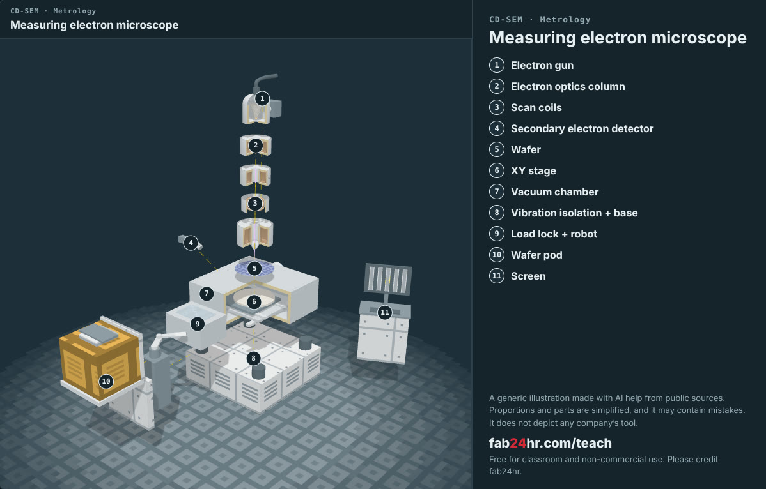
Semiconductors 101, unit 17 · Look: machines to take apart
fab24hr.com/en/learn/metrology/
fab24hr
Notes:
Measuring electron microscope：https://fab24hr.com/en/?tool=cdsem

Slide 12

Semiconductors 101, unit 17
Play
Start at chapter 2, "Station by Station": on day 2, go to the metrology tool and measure the monitor wafers from the furnace load
Scan with a phone to play from here
fab24hr.com/en/?story=2&utm_source=slides
fab24hr.com/en/learn/metrology/
fab24hr

Slide 13
Semiconductors 101, unit 17
Think
1 Measuring more is reassuring; measuring less keeps lots moving. If a tool you look after has been a little unsteady lately, how would you decide how many more lots to measure? Who would you talk to first?
2 "Compare with the chip next door" can't find a problem every chip shares. In your own life or work, is there a mistake you can't see because everything has it? How would you find it?
fab24hr.com/en/learn/metrology/
fab24hr

Slide 14
Semiconductors 101, unit 17
Read
How does a chip fab know each step went right? Metrology vs inspection
fab24hr.com/en/blog/what-is-metrology/
What is wafer defect inspection, and how do fabs find particles and scratches?
fab24hr.com/en/blog/defect-inspection/
fab24hr.com/en/learn/metrology/
fab24hr

Slide 15
Semiconductors 101, unit 17
Semiconductors 101: a free course following the life of a chip
https://fab24hr.com/en/learn/metrology/
Written from public textbooks, industry standards, university course notes and papers; the companies, people, machine numbers and figures in the game are fictional.
Free to use in class and for non-commercial teaching. Please credit fab24hr. Do not sell it or present it as your own work.
Generic illustration made with AI help from public sources; may contain mistakes; not any company’s tool
fab24hr.com/en/learn/metrology/
fab24hr

