Slide 1
Semiconductors 101, unit 23
The people in a fab: roles, shifts and careers
A fab is not just machines. This unit looks at its departments, who talks to whom every day and who does what first when something goes wrong, then at the jobs inside and what shift work and being on call involve.
Semiconductors 101: a free course following the life of a chip
Free to use in class and for non-commercial teaching. Please credit fab24hr. Do not sell it or present it as your own work.
fab24hr.com/en/learn/people/
fab24hr
Notes:
A fab is not just machines. This unit looks at its departments, who talks to whom every day and who does what first when something goes wrong, then at the jobs inside and what shift work and being on call involve.

Slide 2
Semiconductors 101, unit 23
Goals
1 Say what Manufacturing, Process, Equipment, Integration, QA, Production control and Facilities each look after, and why every department talks to several others every day.
2 Say who does what when something goes wrong: who stops the lot, who finds the cause, who decides on each wafer, who checks the rules were followed and who replans; and tell the work of a process engineer from that of an equipment engineer.
3 Look at shifts, on-call duty and working hours through public information: what comes with the job itself, and what differs from company to company.
fab24hr.com/en/learn/people/
fab24hr

Slide 3
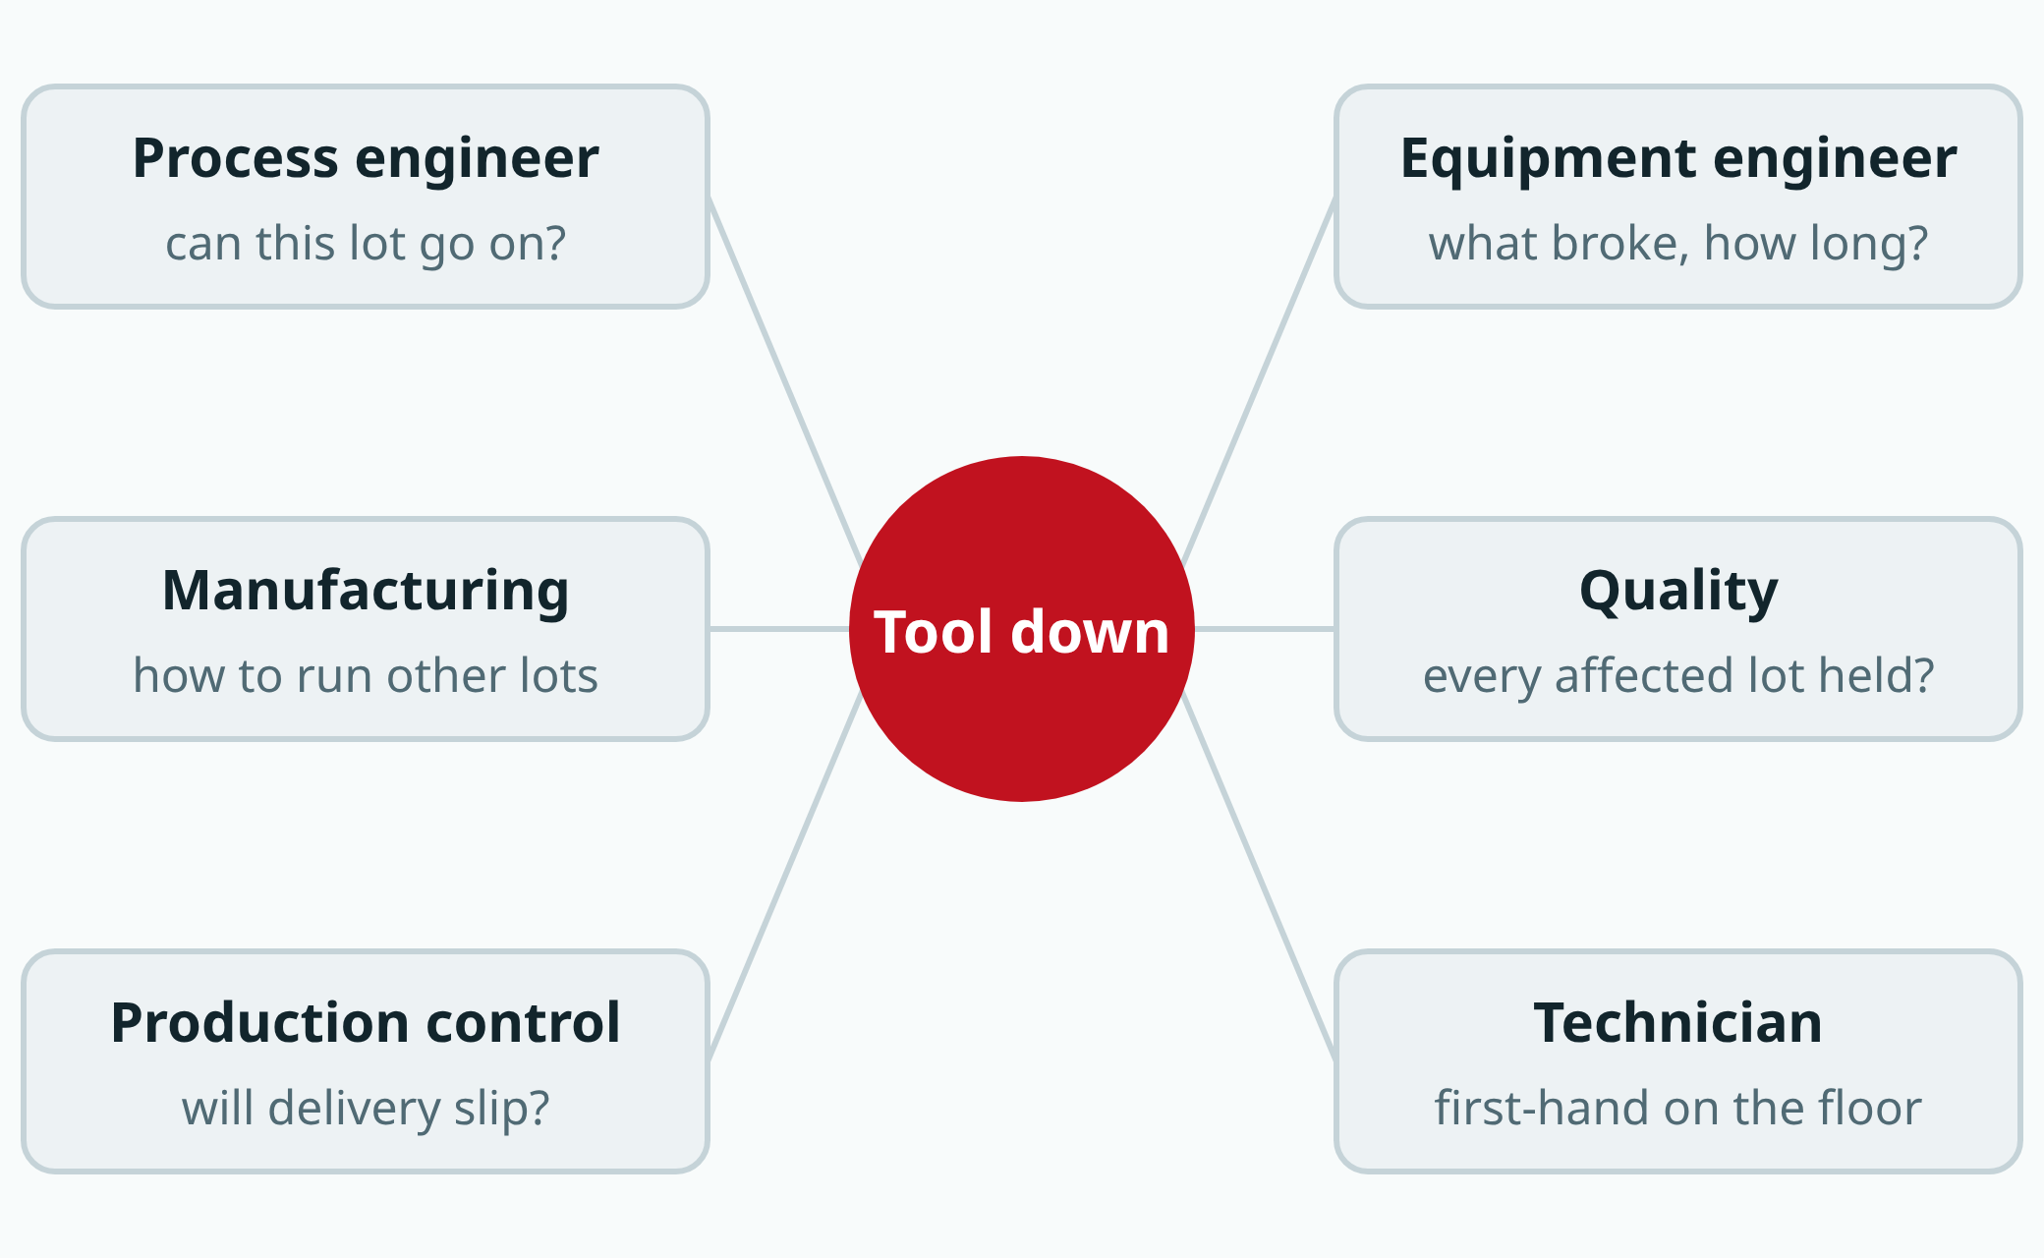
Semiconductors 101, unit 23
At the same moment, each role worries about something different.
fab24hr.com/en/learn/people/
fab24hr
Notes:
The moment a machine stops: the process engineer asks whether this lot can still go on, the equipment engineer asks what broke and how long the repair will take, Manufacturing asks how to schedule the other lots, quality asks whether every affected lot is held, production control asks whether delivery will slip, and the technician sees the situation first-hand.

Slide 4
Semiconductors 101, unit 23 · Key ideas 1/4
First, which stage of the chip's journey?
Semiconductor jobs are first sorted by the path a chip takes: a design company designs the circuit, a wafer fab builds it layer by layer on wafers, a test-and-assembly house tests and packages every chip, and other companies supply the tools and materials. These stages are often different companies with different rhythms: a design company has no production line, so nobody works shifts for the tools, while a fab's tools run 24 hours a day. So two people with the same title, engineer, can face very different days depending on the stage.
fab24hr.com/en/learn/people/
fab24hr

Slide 5
Semiconductors 101, unit 23 · Key ideas 2/4
Inside a fab, roles follow what each person looks after
A wafer goes back and forth between areas through hundreds of steps, over weeks to months. How to fix a tool, how to set a condition, which lot goes first, how to keep the water, power and gases running: no one person can know it all, so the work is divided. Manufacturing keeps lots moving from step to step, process engineering owns whether each step comes out right, equipment engineering looks after the tools, process integration owns whether hundreds of steps fit together, yield and failure analysis find where chips fail, quality assurance owns the quality system (checks before shipping, customer complaints, and whether problems are handled by the rules and the fixes really work), Production control plans when each lot finishes and ships, and Facilities supplies the water, power, gases and chemicals; companies split and name these differently. It's like a big hospital: each department looks after one part, but the patient is the same, and here the patients are the lots of wafers. So every department talks to several others every day: Manufacturing most often asks Equipment "when is the tool back?", Process "can this lot go on?" and Production control "which lots first?" At the tools are technicians who work by the standard operating procedure (SOP).
fab24hr.com/en/learn/people/
fab24hr

Slide 6
Semiconductors 101, unit 23 · Key ideas 3/4
When something goes wrong, it's a relay: Process looks after wafers, Equipment after machines
Say the line width measured after a step is out of spec. Manufacturing and the technicians first follow the out-of-control action plan written in advance (the OCAP): they put the lot on hold, stop the tool if it has to stop and call the engineer whose turn it is to be on call. Stopped now, a bad lot doesn't go one step further. Then Process and Equipment investigate together: Process looks at the wafers, first checking it isn't a measurement error, then looking at when the numbers started to drift and which other lots ran on the same tool, and holding those too; Equipment looks at the machine itself, checking the tool's logs and parts. The cause could be in the conditions or in the hardware, and looked at separately, each side sees only half. Once it's fixed, Equipment hands the tool back and Process tries it with test wafers, and it goes back to production only when both pass: fixed hardware doesn't mean the wafers will come out just as well. Integration, often together with Process, looks at whether later steps will be affected and decides wafer by wafer: continue, rework or scrap. QA checks the decision followed the rules and the right people signed; Production control replans, and if a due date moves, sales tells the customer. Sometimes every department's own records are right and the problem sits in the handoff to the next person.
fab24hr.com/en/learn/people/
fab24hr

Slide 7
Semiconductors 101, unit 23 · Key ideas 4/4
Shifts and on-call: what comes with the job?
Tools that never stop and problems that come at any hour come with the job itself. Technicians and Manufacturing staff mostly work shifts, commonly 12 hours long with four crews taking turns; guidance from occupational safety and health agencies says such long shifts call for more rest days and enough time between shifts to sleep. Engineers mostly work days and take turns being on call, and when a decision is needed at night, the phone rings; in many fabs, equipment and facilities engineers work shifts too. The shift pattern, how often you are on call and whether you have to go in differ from company to company.
fab24hr.com/en/learn/people/
fab24hr

Slide 8
Semiconductors 101, unit 23
Common misconceptions
People say: Chip fabs only hire electrical engineers.
In fact: Making a chip uses chemistry, physics, electronics, mechanics and a lot of data at once, so chemical engineering, chemistry, materials, physics, mechanical engineering, industrial engineering and computer science all lead to common roles. A degree is only a starting point, and many people cross over; the bigger difference is whether you like facing wafers, machines, data or the whole production line every day.
People say: Every job in the semiconductor industry is equally grueling.
In fact: It depends a lot on the role and the period. Shift and on-call patterns differ from role to role, and design companies don't work shifts for tools. Things get especially busy when new tools move in, a new process starts up or yield has a problem, but that is not every day. Rather than asking whether it's tiring, ask concrete questions: is there shift work, how often are you on call, how often do day and night shifts swap?
fab24hr.com/en/learn/people/
fab24hr

Slide 9

Semiconductors 101, unit 23
Play
Play one shift in one role, then the same shift in another role, and compare
Scan with a phone to play from here
fab24hr.com/en/?utm_source=slides
fab24hr.com/en/learn/people/
fab24hr

Slide 10
Semiconductors 101, unit 23
Think
1 A machine fails in the middle of the night. Who should be woken up? What does waking someone cost, and what does not waking them cost?
2 At the same moment, say when a machine goes down, what are process, equipment and Manufacturing each worried about? Which role would you most and least like to have, and why?
fab24hr.com/en/learn/people/
fab24hr

Slide 11
Semiconductors 101, unit 23
Read
What departments does a chip fab have, and who talks to whom every day?
fab24hr.com/en/blog/fab-org/
What jobs are there in the semiconductor industry? From chip design to the fab to test
fab24hr.com/en/blog/semi-jobs/
What's the difference between a process engineer and an equipment engineer?
fab24hr.com/en/blog/pe-vs-ee/
Is working in a semiconductor fab hard? Shifts, on-call and hours
fab24hr.com/en/blog/fab-work-hard/
Further
What's the difference between a fab technician and an engineer?
Which degrees work in a chip fab, and what does each one do there?
What does an equipment engineer do in a chip fab?
What does the manufacturing department do in a chip fab, and how are lots scheduled?
fab24hr.com/en/learn/people/
fab24hr

Slide 12
Semiconductors 101, unit 23
Semiconductors 101: a free course following the life of a chip
https://fab24hr.com/en/learn/people/
Written from public textbooks, industry standards, university course notes and papers; the companies, people, machine numbers and figures in the game are fictional.
Free to use in class and for non-commercial teaching. Please credit fab24hr. Do not sell it or present it as your own work.
Generic illustration made with AI help from public sources; may contain mistakes; not any company’s tool
fab24hr.com/en/learn/people/
fab24hr

