Slide 1
Semiconductors 101, unit 7
How chips are made: the big picture
A wafer goes through hundreds of steps over several months in a fab. Look at the whole map first; the next units zoom in one area at a time.
Semiconductors 101: a free course following the life of a chip
Free to use in class and for non-commercial teaching. Please credit fab24hr. Do not sell it or present it as your own work.
fab24hr.com/en/learn/process-flow/
fab24hr
Notes:
A wafer goes through hundreds of steps over several months in a fab. Look at the whole map first; the next units zoom in one area at a time.

Slide 2
Semiconductors 101, unit 7
Goals
1 Outline the rough order a chip goes through: design, photomasks, the fab, testing and packaging.
2 Say what each of the fab's seven process areas does: wet clean, furnace, thin film, litho, etch, CMP and implant.
3 Explain that a chip is built up layer by layer: deposit a material, print a pattern, remove what is not needed, and repeat many times.
fab24hr.com/en/learn/process-flow/
fab24hr

Slide 3
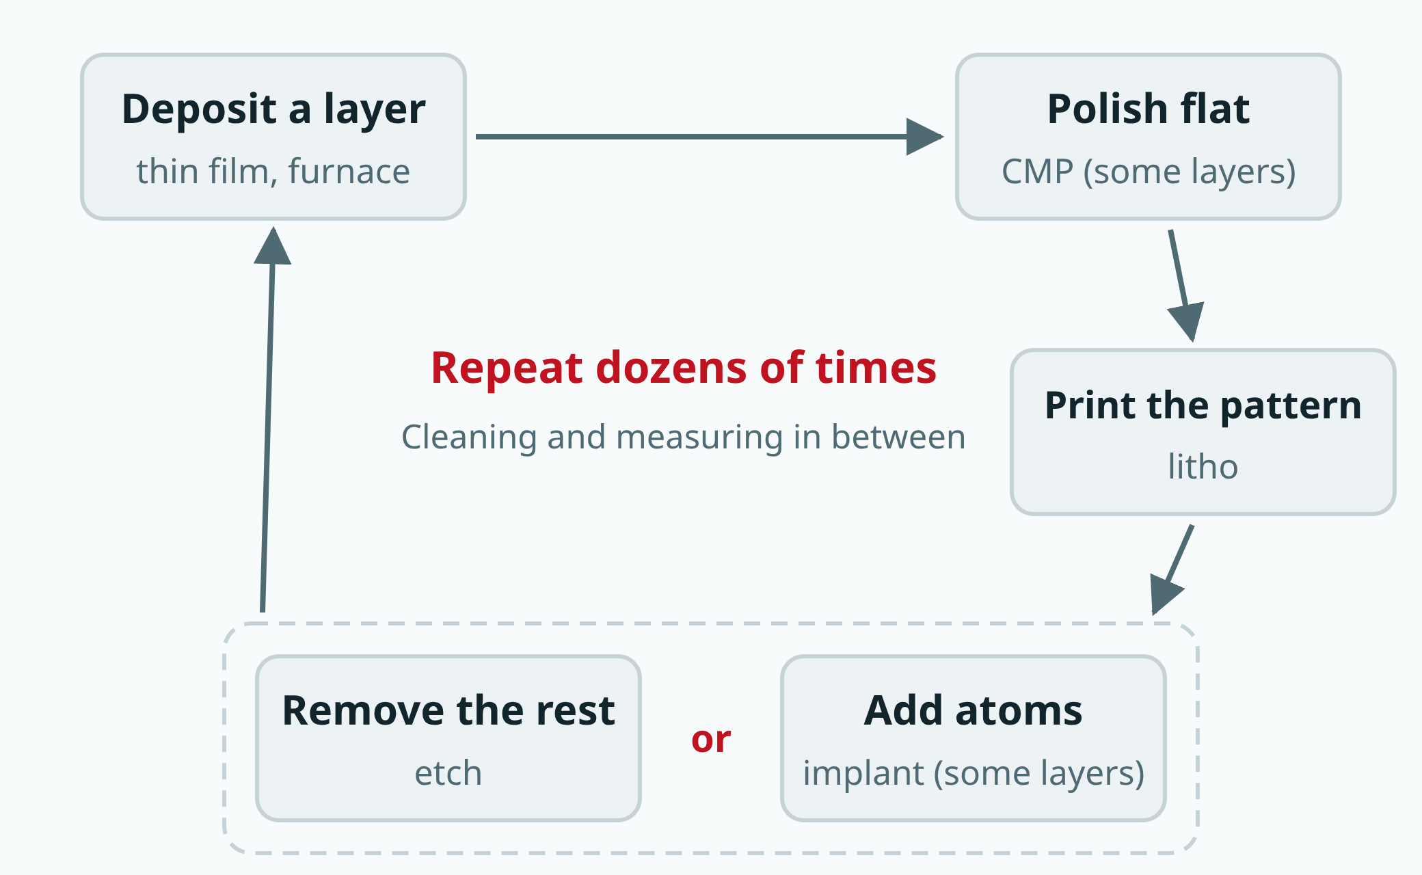
Semiconductors 101, unit 7
Each layer goes roughly once around the loop: once the pattern is printed, it is etched or implanted; not every layer is implanted or polished. The print is measured first, the resist is stripped after etch or implant, and cleaning and measuring happen between the steps.
fab24hr.com/en/learn/process-flow/
fab24hr
Notes:
A chip is built layer by layer: deposit a material, polish it flat on some layers, print a pattern, then etch away what is not needed or implant atoms, and repeat dozens of times; cleaning and measuring happen between the steps.

Slide 4
Semiconductors 101, unit 7 · Step by step 1/2
Step by step
1 Build in layers: transistors in the silicon first, then metal wiring stacked above.
Why: A chip is like a building: the transistors at the bottom are switches, and the wiring above connects them. Between the transistors and the wiring, small, deep holes filled with metal make the connection up and down; these holes are called contacts.
If not: Switches with no wiring between them stay separate and can't form a circuit that computes; a hole that isn't etched to the bottom or isn't filled leaves the layers unconnected.
2 Give each layer one round: deposit a film, polish if needed, print the pattern, measure (redo if wrong), etch or implant, strip the resist, clean, then measure a few wafers.
Why: There must be material before anything can be cut, and resist covers what stays so only the open areas are etched or implanted.
If not: A surface that isn't polished flat stays uneven, so the next layer's pattern prints blurry and lines up poorly.
3 Repeat the round dozens of times, hundreds of steps in all, and keep every step steady.
Why: A complex chip has dozens of layers, and each one goes back to litho to print its own pattern.
If not: If each step is just slightly short, hundreds of steps multiplied together cost a lot of yield (the share of chips that come out good) in the end.
fab24hr.com/en/learn/process-flow/
fab24hr

Slide 5
Semiconductors 101, unit 7 · Step by step 2/2
Step by step
4 Group tools that do the same job into areas (this course follows the game's seven; real fabs split them in different ways), and move the wafers back and forth among them.
Why: Tools doing the same job are easier to keep in tune side by side, and people can split the work.
If not: With the same kind of tool scattered around, settings are hard to keep matched and work is hard to split; besides, each layer comes back to the same kind of tool, so the route was never a straight line.
5 Plan the quantity on the day of wafer start (going onto the line): a lot takes weeks to months from there to finished.
Why: There are hundreds of steps, and most of the time goes to waiting in line at tools, not to processing.
If not: Unless some part-finished wafers were kept waiting for this, wafers added halfway must start again from the first step, which means another weeks to months.
fab24hr.com/en/learn/process-flow/
fab24hr

Slide 6
Semiconductors 101, unit 7 · Key ideas 1/4
Design and photomasks come before the fab
A fab builds from a drawing. Engineers first design the circuit on computers and simulate and check it many times. When it's final, the design is handed over; this is called tape-out. The design is then made into a set of photomasks, at least one for each layer's pattern, like stencils for printing the circuit. Once the wafers and the photomasks are both at the fab, a batch of wafers goes onto the production line, which is called a wafer start, and hundreds of steps over weeks to months begin.
fab24hr.com/en/learn/process-flow/
fab24hr

Slide 7
Semiconductors 101, unit 7 · Key ideas 2/4
Seven process areas, each with one job
Tools that do the same job sit together, and that is an area. Wet clean washes off dirt too small to see. The furnace slides more than a hundred wafers into a very hot tube to grow an oxide layer that doesn't conduct, or to heat implanted atoms into place (annealing). Thin film lays down a new layer of material. Litho coats the wafer with light-sensitive photoresist and shines light through a photomask to print the pattern. Etch cuts away what the pattern doesn't protect. CMP (chemical mechanical polishing, also called planarization) polishes the surface flat. Implant shoots atoms such as boron or phosphorus into the silicon to decide where it conducts.
fab24hr.com/en/learn/process-flow/
fab24hr

Slide 8
Semiconductors 101, unit 7 · Key ideas 3/4
A chip is built like a building, floor by floor
At the bottom of a chip are the transistors, built into the silicon; above them, layer after layer of very fine metal wires connect the switches. Each layer has a different shape, so each one needs its own round: add a layer of material, polish it flat if needed, print its pattern with litho, etch or implant through it, clean, then start the next. Complex chips need dozens of patterned layers (a dozen or more metal layers, plus the vias between them and the transistor layers below, the finest printed in two or three passes), so a wafer comes back to litho dozens of times, and it all adds up to hundreds of steps, over a thousand for the most complex.
fab24hr.com/en/learn/process-flow/
fab24hr

Slide 9
Semiconductors 101, unit 7 · Key ideas 4/4
Then test, cut, package, and test again
Building the circuit on the wafer, the transistors and the wiring above them alike, is what the industry usually calls the "front end"; testing, cutting and packaging the finished wafers at a test-and-assembly house is the "back end". Inside a fab, engineers sometimes use the same two words for the transistor half and the wiring half of the process, so read them in context. First, very fine needles touch the contacts of every chip on the finished wafer, power it up and test it; this is called wafer sort, done at the fab, the test-and-assembly house or a dedicated test house, and bad chips caught now don't cost money to package. Then the wafer is cut into separate chips, and each goes into a package that protects the thin, brittle chip and brings its contacts to the outside. Each packaged chip is tested again, because packaging can damage it too and some tests can only be done fully once it is packaged; only the good ones ship.
fab24hr.com/en/learn/process-flow/
fab24hr

Slide 10
Semiconductors 101, unit 7
Common misconceptions
People say: During its months in the fab, a wafer is being processed the whole time.
In fact: From wafer start to a finished wafer, most of the time isn't spent being processed but waiting in line at the tools. The tools are expensive and every wafer stays in the line that long, which is why fabs run 24 hours a day, with people working in shifts.
People say: What comes out of a fab is a pile of chips ready to use.
In fact: A fab ships whole wafers, with the chips still joined together and not yet tested one by one. Only at a test-and-assembly house are they tested, cut apart and packaged into parts that can go into a product.
fab24hr.com/en/learn/process-flow/
fab24hr

Slide 11
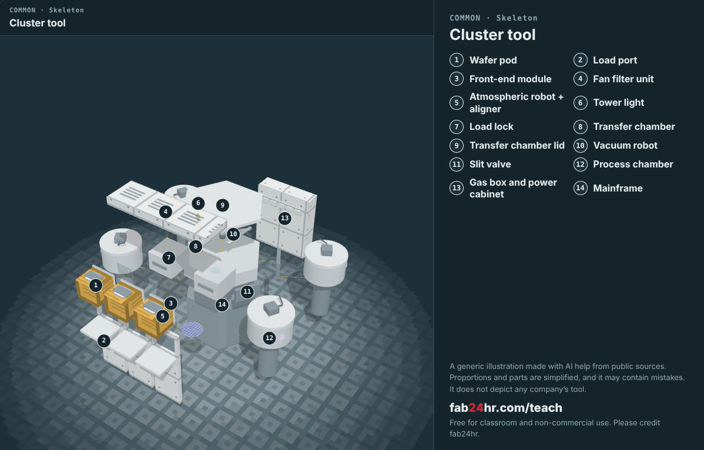
Semiconductors 101, unit 7 · Look: machines to take apart
fab24hr.com/en/learn/process-flow/
fab24hr
Notes:
Cluster tool：https://fab24hr.com/en/?tool=cluster

Slide 12

Semiconductors 101, unit 7
Play
Start at chapter 2, "Station by Station": one hands-on step in each of the seven process areas
Scan with a phone to play from here
fab24hr.com/en/?story=2&utm_source=slides
fab24hr.com/en/learn/process-flow/
fab24hr

Slide 13
Semiconductors 101, unit 7
Think
1 Why is a chip built by repeating "deposit, print, etch" layer after layer rather than all at once? Try explaining it with house building or another everyday example.
2 A wafer spends months in the fab. Over such a long process, where do you think the biggest risk lies, and how could it be caught early?
fab24hr.com/en/learn/process-flow/
fab24hr

Slide 14
Semiconductors 101, unit 7
Read
How are computer chips made? The semiconductor manufacturing process, step by step
fab24hr.com/en/blog/how-chips-are-made/
What do the seven process areas of a chip fab do?
fab24hr.com/en/blog/fab-process-areas/
Further
What is a wafer start, and why does a fab count from that day?
What is a fab in semiconductors, and what does "going into the fab" mean?
What is a recipe in semiconductor manufacturing?
fab24hr.com/en/learn/process-flow/
fab24hr

Slide 15
Semiconductors 101, unit 7
Semiconductors 101: a free course following the life of a chip
https://fab24hr.com/en/learn/process-flow/
Written from public textbooks, industry standards, university course notes and papers; the companies, people, machine numbers and figures in the game are fictional.
Free to use in class and for non-commercial teaching. Please credit fab24hr. Do not sell it or present it as your own work.
Generic illustration made with AI help from public sources; may contain mistakes; not any company’s tool
fab24hr.com/en/learn/process-flow/
fab24hr

