Slide 1
Semiconductors 101, unit 22
Reliability, shipping and building chips into products
Testing only asks whether a chip is good "right now", but it has to work inside a product for years. This unit looks at how a few weeks can tell you about years from now, how weak chips are screened out, and how chips are packed, shipped and soldered onto circuit boards to end up in the products in your hands.
Semiconductors 101: a free course following the life of a chip
Free to use in class and for non-commercial teaching. Please credit fab24hr. Do not sell it or present it as your own work.
fab24hr.com/en/learn/reliability/
fab24hr
Notes:
Testing only asks whether a chip is good "right now", but it has to work inside a product for years. This unit looks at how a few weeks can tell you about years from now, how weak chips are screened out, and how chips are packed, shipped and soldered onto circuit boards to end up in the products in your hands.

Slide 2
Semiconductors 101, unit 22
Goals
1 Say what a reliability test asks, how accelerated conditions let a few weeks stand in for years, and what each of the common tests checks.
2 Read the bathtub curve, tell reliability testing (a sample) from burn-in (every chip), and know why lots with very low yield call for extra care.
3 Say how chips go into tape and reel, why moisture-sensitive ones need a dry pack, and how an assembly plant solders them onto circuit boards with SMT.
fab24hr.com/en/learn/reliability/
fab24hr

Slide 3
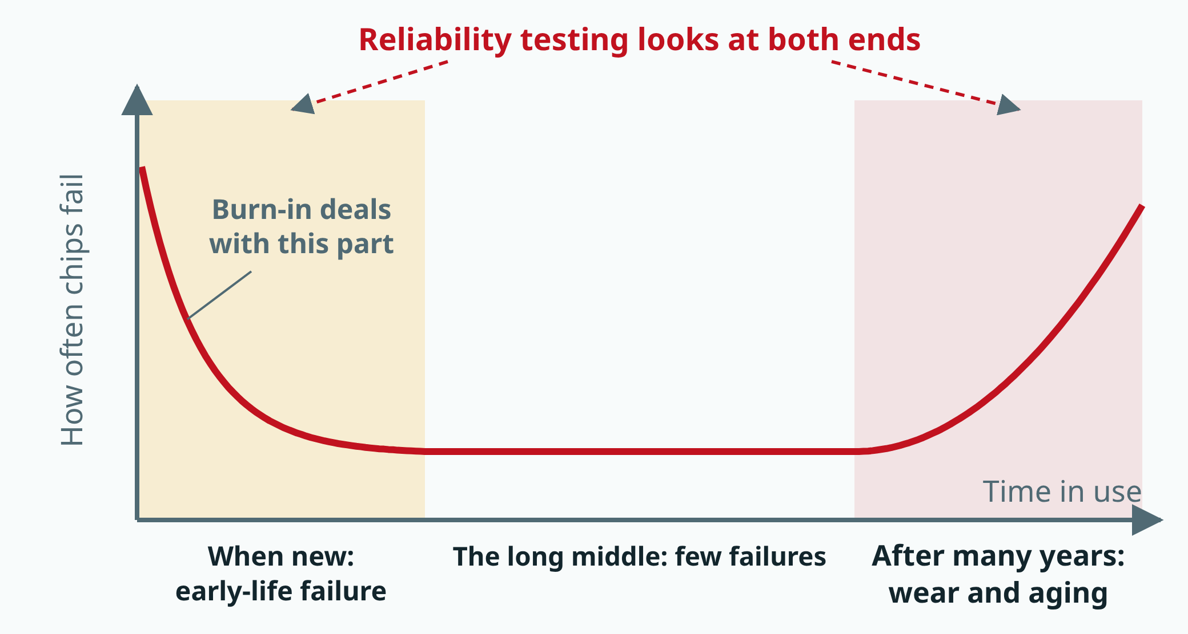
Semiconductors 101, unit 22
When chips tend to fail: burn-in screens every chip through the early part; reliability testing takes a sample and looks at both ends, how high the start is and how long until the end turns up. A sketch, no numbers.
fab24hr.com/en/learn/reliability/
fab24hr
Notes:
Sketch of the bathtub curve: time in use across, and up the side, how often chips fail at that time. Chips fail more often when new (early-life failure), rarely through a long middle stretch, and more often again after many years as they wear and age. Burn-in deals with the first part; reliability testing looks at both ends.

Slide 4
Semiconductors 101, unit 22 · Step by step 1/3
Step by step
1 Before mass production, run reliability tests: sample several lots and run them for over a thousand hours, hotter and at higher voltage than normal.
Why: A chip has to last for years, and nobody can wait years; with harsher conditions, aging happens within a few weeks.
If not: Checking only whether a new chip works can't show what takes years to happen, such as wires thinning or an insulating layer breaking down.
2 Before shipping, deal with the weak ones: for demanding products, burn in every chip and pull out the weak ones; where not every chip is burned in, a few hundred are often taken from a batch and run for a day or two to see whether the batch is roughly good.
Why: A chip with a small flaw passes every test and fails after weeks or months of use; this is early-life failure.
If not: The weak ones fail in users' hands instead; a failure in a car or a hospital costs a lot.
3 Put only chips that passed test, one by one, into the pockets of a tape, all facing the same way, and wind it onto a reel.
Why: The customer's machine pulls the tape forward one pocket at a time and picks up each chip; because they all face the same way, it knows where pin 1 is.
If not: Chips facing the wrong way get placed anyway, and the board may not work or may even burn out.
fab24hr.com/en/learn/reliability/
fab24hr

Slide 5
Semiconductors 101, unit 22 · Step by step 2/3
Step by step
4 Check the moisture sensitivity level (MSL); bake the sensitive ones dry and seal them in a moisture barrier bag with desiccant and a humidity card.
Why: A plastic package soaks up water, and soldering heats it to over 200 °C; the water turns to steam and can push the package apart or crack it.
If not: The chips take on water day by day on the road and in the warehouse, and arrive at the customer already damp.
5 Label every reel and bag; on sensitive ones, add the level, the seal date and how long you have to solder the parts after opening.
Why: The label tells the customer how long the parts can still sit out, and if something goes wrong, the lot number leads all the way back to the batch of wafers at the fab.
If not: Without the seal date, the customer can't work out how long the bag is still good for.
6 At the assembly plant, check the humidity card when the bag is opened and solder the parts within the set time; if the card has changed color or the time has passed, bake them dry first.
Why: Once the bag is open, the chips start taking in water again; the more sensitive the level, the shorter the time they can sit out.
If not: Left too long and not baked before the oven, the moisture turns to steam and pries the package and the chip apart: popcorning.
fab24hr.com/en/learn/reliability/
fab24hr

Slide 6
Semiconductors 101, unit 22 · Step by step 3/3
Step by step
7 Solder them on with SMT: print solder paste, place the parts, run the board through a reflow oven, then check the joints.
Why: The solder has to melt and set again to hold; big parts heat up slowly, so the oven warms gently first, then rises to over 200 °C.
If not: Too cool or too short and the joints are weak; too hot or too long and the parts get damaged; a bad board found only once it's in a product is harder and more expensive to track down.
fab24hr.com/en/learn/reliability/
fab24hr

Slide 7
Semiconductors 101, unit 22 · Key ideas 1/4
Testing asks "is it good now?"; reliability asks "will it still be good in a few years?"
Every chip is powered up and tested before it ships, usually twice; but chips age. Metal atoms in the wires get pushed along by the current, and over time a wire can thin out or even break; the very thin insulating layer in a transistor is under voltage all the time and over time can break down; the chip, the plastic package and the solder joints expand and shrink by different amounts with heat, so they pull on each other every time things heat up and cool down. These take years to cause trouble, yet nobody can wait years before selling, so the answer is to speed things up: many of the chemical reactions that age a chip run faster the hotter it gets, the way milk left on the counter goes bad faster than milk in the fridge, and a little more voltage makes weak spots show up sooner; moisture and repeated heating and cooling work the same way. With conditions harsher than normal, aging happens within a few weeks, and the results are worked back to how long the chips would last in normal use. But you can't push it without limit: too hot, and failures can appear that would never happen in normal use, such as materials going soft, and then the results say nothing about real use.
fab24hr.com/en/learn/reliability/
fab24hr

Slide 8
Semiconductors 101, unit 22 · Key ideas 2/4
How it's done: sample several lots, measure along the way, find out why any chip failed
Reliability testing works on a sample: a few dozen chips from each of several lots, made and packaged the way mass production will make them; a sample from one lot might happen to come from the best one. The chips are plugged into boards and pushed into an oven, then powered, heated and left to run, coming out every few hundred hours to be measured one by one; measuring along the way shows when they started to go bad. A common test is high-temperature operation (HTOL): over 100 °C with voltage applied for 1,000 hours, about six weeks, and a common standard is three lots of 77 chips each, with not a single failure. There are also temperature cycling (do the joints inside the package crack?), high temperature and humidity (does moisture get through the plastic and corrode the wires?) and static electricity (can the protection circuits stop it?). Any failed chip is opened up to find out why: the cause may be in the process, the design or the package, and each needs a completely different fix. Which tests to run and how many chips to take are set out in public standards, and chips that go into cars are tested more, and more strictly. Reliability is mostly tested before mass production, and it is one of the items checked before a chip is handed to the production fab.
fab24hr.com/en/learn/reliability/
fab24hr

Slide 9
Semiconductors 101, unit 22 · Key ideas 3/4
The bathtub curve: burn-in pulls out the early failures
Put a large batch of identical chips into use, count how many fail in each stretch of time, and the drawing looks like a bathtub. When they're new, more fail, mostly from small flaws left over from manufacturing, such as a fine wire not bonded firmly enough: they pass every test and fail after weeks or months of use. This is early-life failure. Through a long stretch in the middle, very few fail, more like bad luck; after many years, the materials wear and failures climb again. Reliability testing looks at both ends, how high the left end is and how long the chips hold out before the right end turns up, and it works on a sample: it asks how long this kind of chip lasts. Burn-in deals only with the left end, and it covers every chip: before shipping, each one runs powered, usually at over 100 °C and a slightly higher voltage than normal for a few hours to a few days, so the weak ones fail at the factory; the chips are then tested again, and the failures are pulled out before the rest ship. When not every chip is burned in, one compromise is to take a few hundred from a batch and run them for a day or two to see whether the batch is roughly good; if many fail, the batch is looked into before it ships. But sampling can't pull out every weak chip: the ones that weren't picked still ship as they are.
fab24hr.com/en/learn/reliability/
fab24hr

Slide 10
Semiconductors 101, unit 22 · Key ideas 4/4
Packed, shipped, then soldered onto a board
Shipping has to look after two things at once: which way the chips face, and keeping them dry. Tested chips mostly go one by one into the small pockets of a tape (some go in tubes or trays instead), all facing the same way, so the customer's machine knows which side pin 1 (where the pin numbering starts) is on. The plastic around a chip slowly takes on moisture from the air; soldering heats it to over 200 °C, and the water turns to steam all at once. In mild cases it pushes the plastic away from the chip (delamination); in bad cases the whole package cracks. This is called popcorning. So every kind of plastic package that sits on the surface of a board has a moisture sensitivity level (MSL): sensitive ones are baked dry and sealed in a moisture barrier bag, and once the bag is open they have to be soldered within a set time. Soldering is mostly done at an assembly plant, with SMT (surface mount technology): parts don't go through holes in the board but are soldered onto its surface, so they can be smaller and both sides of the board can carry them. A wafer fab has no SMT line; the test-and-assembly house packages the chips and puts them on reels, and the assembly plant solders them onto circuit boards and builds them into phones and computers.
fab24hr.com/en/learn/reliability/
fab24hr

Slide 11
Semiconductors 101, unit 22
Common misconceptions
People say: The good chips picked out of a low-yield lot have all been tested, so they're as reliable as any other lot's.
In fact: Not necessarily. Very low yield often means those wafers or lots were hit by especially many defects, and some defects aren't big enough to kill a chip on the spot; they leave a small flaw that passes the tests but makes the chip weaker. Studies have found that in wafers and lots with very low yield, a higher share of the chips that passed their tests fail early later on. It's a statistical tendency, not a sign that every chip has a problem; demanding products give these an extra screen, such as burn-in, or handle them separately.
People say: Burn-in pulls out the weak chips, so the safest thing is to burn in every chip of every kind, and for longer.
In fact: Burn-in has a cost: every batch waits a few more hours to a few days, and shipping slips with it; it takes dedicated equipment with every chip powered, which takes up space and uses power; the chips that burn out had counted as good, so yield drops; and burned in too long, good chips use up a little of their life as well, pushed early toward the right side of the tub. So it's more common where a failure is very costly, such as chips in cars and medical devices. The more basic fix is to find which step the small flaws come from and fix the process; once early-life failures are rare enough, burn-in can be shortened, or phased out over time.
fab24hr.com/en/learn/reliability/
fab24hr

Slide 12
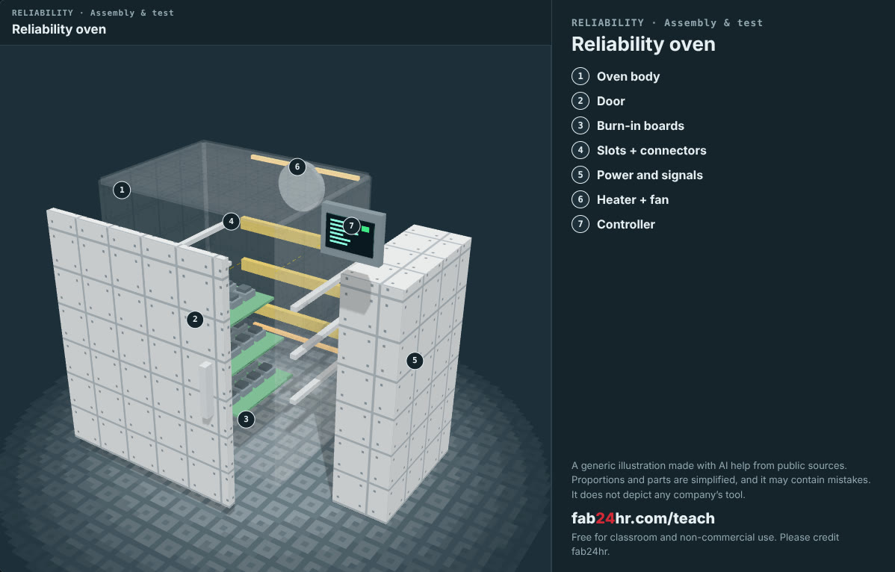
Semiconductors 101, unit 22 · Look: machines to take apart
fab24hr.com/en/learn/reliability/
fab24hr
Notes:
Reliability oven：https://fab24hr.com/en/?tool=burnin

Slide 13
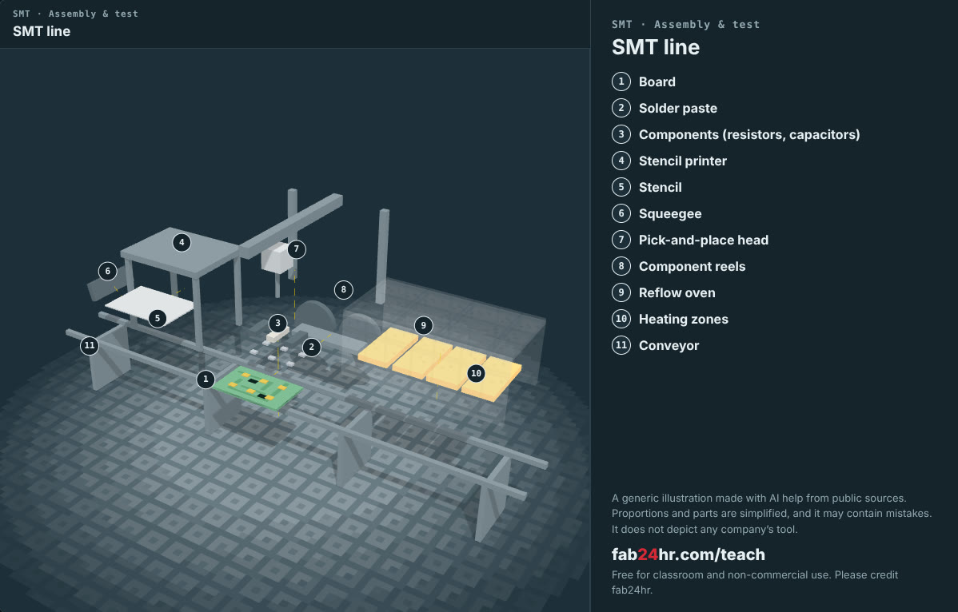
Semiconductors 101, unit 22 · Look: machines to take apart
fab24hr.com/en/learn/reliability/
fab24hr
Notes:
SMT line：https://fab24hr.com/en/?tool=smt

Slide 14

Semiconductors 101, unit 22
Play
Start at chapter 12, "The Night Before Shipping": you decide whether to run a two-day sample for early-life failures or ship tomorrow as planned, then check the dry pack, the last item, in the shipping area
Scan with a phone to play from here
fab24hr.com/en/?story=12&utm_source=slides
fab24hr.com/en/learn/reliability/
fab24hr

Slide 15
Semiconductors 101, unit 22
Think
1 The batch ships tomorrow morning. The reliability lab offers to take a few hundred chips and run them powered at high temperature for two days to check for early-life failures, but the whole batch would ship a week late. If the decision were yours, what would you want to know first? And who would you talk to first?
2 The caution label on a moisture barrier bag is just a few boxes of text: the level, the seal date, how long you have to solder the parts after opening. If you loaded parts onto the machines at an assembly plant, how would you make sure every bag is handled that way? If one box were left empty, who would run into trouble, and when?
fab24hr.com/en/learn/reliability/
fab24hr

Slide 16
Semiconductors 101, unit 22
Read
What is reliability testing, and how can you tell in weeks that a chip will last for years?
fab24hr.com/en/blog/reliability/
How are chips shipped? Tape and reel, dry pack and moisture sensitivity levels
fab24hr.com/en/blog/chip-shipping/
How are chips soldered onto circuit boards? SMT and reflow soldering
fab24hr.com/en/blog/smt/
Further
What is burn-in, and why are chips "burned in" before they ship?
fab24hr.com/en/learn/reliability/
fab24hr

Slide 17
Semiconductors 101, unit 22
Semiconductors 101: a free course following the life of a chip
https://fab24hr.com/en/learn/reliability/
Written from public textbooks, industry standards, university course notes and papers; the companies, people, machine numbers and figures in the game are fictional.
Free to use in class and for non-commercial teaching. Please credit fab24hr. Do not sell it or present it as your own work.
Generic illustration made with AI help from public sources; may contain mistakes; not any company’s tool
fab24hr.com/en/learn/reliability/
fab24hr

