Slide 1
Semiconductors 101, unit 10
Thin film: building up layer by layer
Almost every layer of a chip starts with a new film of material, so that there is something to print and etch. How thick, how even and how clean the film is carries on into etch, polishing and the next litho step.
Semiconductors 101: a free course following the life of a chip
Free to use in class and for non-commercial teaching. Please credit fab24hr. Do not sell it or present it as your own work.
fab24hr.com/en/learn/thin-film/
fab24hr
Notes:
Almost every layer of a chip starts with a new film of material, so that there is something to print and etch. How thick, how even and how clean the film is carries on into etch, polishing and the next litho step.

Slide 2
Semiconductors 101, unit 10
Goals
1 Say what a thin film is, why almost every layer starts with one, and how it differs from oxidation in a furnace and from epitaxy, which follows the wafer's crystal grid.
2 Tell where the film comes from in CVD, sputtering and ALD and what each is good at, and explain why many tools pump down to a vacuum first and why the opening of a deep hole closing first is a problem.
3 Explain why a film has to be even, free of particles and must not bend the wafer too much, and how it is measured afterward.
fab24hr.com/en/learn/thin-film/
fab24hr

Slide 3
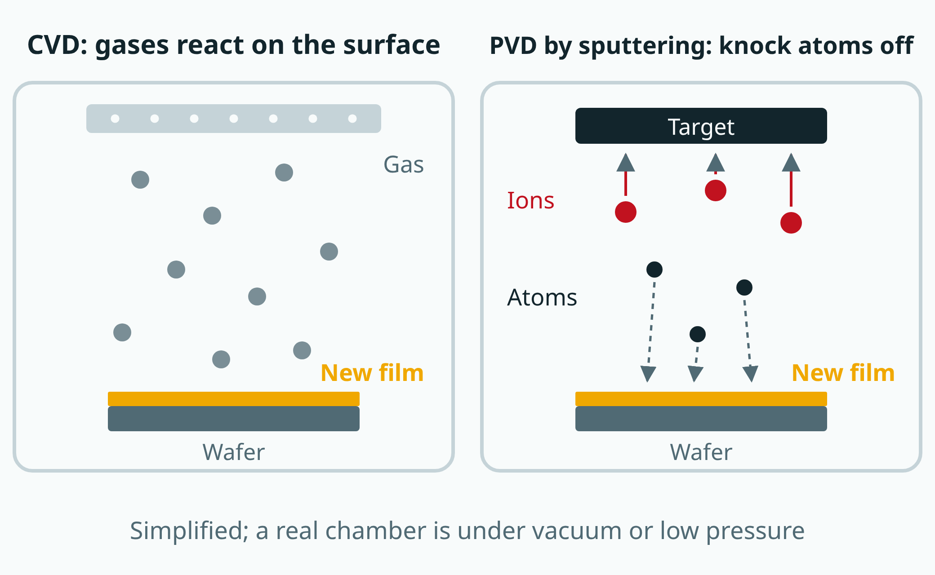
Semiconductors 101, unit 10
Two ways to deposit a film. In CVD, gases react on the surface; sputtering, the most common kind of PVD, knocks atoms off a target and lays them down.
fab24hr.com/en/learn/thin-film/
fab24hr
Notes:
Left: chemical vapor deposition, where gas comes down from a showerhead and reacts on the wafer surface to grow a film. Right: sputtering, the most common kind of physical vapor deposition, where ions strike a target and knock atoms off it onto the wafer.

Slide 4
Semiconductors 101, unit 10 · Step by step 1/3
Step by step
1 First lay a thin film on the wafer, insulating or conducting.
Why: There has to be a layer of material before a pattern can be printed and the unwanted parts cut away.
If not: If the thickness is off, a thin metal film has higher resistance and a thin insulating film may not insulate.
2 Pick the method by what the film is and where it goes: CVD grows it from gases, sputtering knocks atoms off a target, ALD adds one atomic layer per round.
Why: CVD reaches the walls and bottoms of holes; sputtering lays metal films fast, but thin at the bottom of holes; ALD is the most even, but slow.
If not: In a deep, narrow hole the top can close first and leave a void inside: invisible from above, but current flows poorly.
3 In sputtering and many other deposition tools, the wafer first goes into a small load lock to be pumped down, then into a chamber that always stays under vacuum, where the film is grown.
Why: Air is too crowded: an atom can't travel a ten-thousandth of a millimeter without being knocked off course; the load lock is small and pumps down fast, so the main chamber doesn't have to be pumped down again for every wafer.
If not: If the chamber leaks or isn't pumped down enough, oxygen and moisture get into the film and oxidize metal films; leaked air can also react with the process gases into a fine powder that lands on wafers as particles.
fab24hr.com/en/learn/thin-film/
fab24hr

Slide 5
Semiconductors 101, unit 10 · Step by step 2/3
Step by step
4 Measure the thickness afterward; the center and edge of each wafer must match.
Why: In the later etch, thin spots break through first while thick spots still need extra etching.
If not: The bigger the difference, the longer the extra etch, and the more the layer under the thin spots can get damaged.
5 With the thickness right, also check whether the film has bent the wafer.
Why: A film pulls or pushes on the wafer and bends it slightly.
If not: Bent too much, the wafer can't be brought into focus in litho.
6 Watch for particles: clean the chamber on schedule, and count particles on test wafers after maintenance.
Why: The film also grows on the chamber walls and parts, and flakes off once it builds up.
If not: A particle buried under the film leaves a bump, and a line above it can break or two lines can touch.
fab24hr.com/en/learn/thin-film/
fab24hr

Slide 6
Semiconductors 101, unit 10 · Step by step 3/3
Step by step
7 Follow deposition with CMP to polish the surface flat, as is often done.
Why: A film follows the shape below, and metal filling trenches leaves an extra layer on top.
If not: If the surface isn't flat, the next litho step can't keep it all in focus; if the extra metal stays, neighboring lines can end up connected.
fab24hr.com/en/learn/thin-film/
fab24hr

Slide 7
Semiconductors 101, unit 10 · What you adjust, what can go wrong 1/2
What you adjust, what can go wrong
Method (CVD, sputtering, ALD)
Changes: Decides where the film comes from, how fast it grows, and whether it reaches the sidewalls and bottoms of deep holes.
If it is off: The wrong choice leaves hole bottoms too thin, or closes the opening first and leaves a void inside.
Deposition time (rounds, for ALD)
Changes: A longer time or more rounds makes a thicker film; in one common ALD process, a round adds only about 0.1 nanometer.
If it is off: Too thin, and metal has higher resistance or an insulator may not insulate; a change in thickness also changes what comes out of CMP next.
Wafer temperature (with or without plasma)
Changes: CVD uses heat to make the gases react; with a plasma, the wafer doesn't need to be as hot.
If it is off: Once metal wiring is on the wafer, too much heat overruns the thermal budget.
fab24hr.com/en/learn/thin-film/
fab24hr

Slide 8
Semiconductors 101, unit 10 · What you adjust, what can go wrong 2/2
What you adjust, what can go wrong
Chamber vacuum and pressure
Changes: The chamber is first pumped lower than the process needs, to clear out stray gases; then gases go in as the recipe (the settings the tool follows) says and a valve holds the pressure at its setting. For sputtering, it is pumped to about a ten-billionth of atmospheric pressure before argon goes in.
If it is off: In sputtering, pressure too high means sputtered atoms get knocked off course on the way and the plasma is harder to keep even; if the chamber wasn't pumped down enough first, leftover oxygen and moisture join the reaction and the film doesn't come out as set.
When to clean the chamber
Changes: Removes the film that built up on the chamber walls and parts.
If it is off: Too late, and the built-up film flakes off and lands on wafers as particles.
fab24hr.com/en/learn/thin-film/
fab24hr

Slide 9
Semiconductors 101, unit 10 · Key ideas 1/6
The first step of every layer: no material, nothing to etch
At the very bottom of a phone chip are more than ten billion transistors, and layer after layer of metal wiring goes on top to connect them, with insulating material between the wires. Every layer follows roughly the same rhythm: lay down a layer of material, print the pattern with litho, then etch away what isn't needed. Thin film is the first step: there has to be a layer before there is anything to etch. Films are usually a few nanometers to a few hundred nanometers thick; insulating films are often silicon dioxide or silicon nitride, and conducting films are mostly metals. People say a film is "grown" either way, but there are two kinds: oxidation in a furnace makes the silicon itself react with oxygen, so the layer grows out of the wafer, while the thin film area brings the material in from outside and lays it on top.
fab24hr.com/en/learn/thin-film/
fab24hr

Slide 10
Semiconductors 101, unit 10 · Key ideas 2/6
Where the film comes from: grown from gases, or knocked off a target, mostly in a vacuum
Chemical vapor deposition (CVD) sends a few gases into a sealed chamber; they come down evenly through a showerhead full of small holes and react chemically on the hot wafer surface, leaving a new solid layer behind. It isn't like moisture condensing on a cold window: the surface has to be hot for the gases to react and turn into a different substance. Physical vapor deposition (PVD) doesn't rely on a chemical reaction. The most common kind is sputtering: a little argon is let in and lit into a plasma (gas that electricity has pulled apart), and the charged argon is pulled by an electric field into a plate of material (the target), knocking atoms off it one by one. They land on the wafer like spray paint, and the target wears thinner until it has to be replaced. Sputtering and most other deposition happen in a chamber pumped down to a vacuum, because ordinary air is too crowded: a sputtered atom can't travel a ten-thousandth of a millimeter before it hits an air molecule and gets knocked off course, oxygen and moisture get into the film, and where a plasma is used, it won't light as one even glow.
fab24hr.com/en/learn/thin-film/
fab24hr

Slide 11
Semiconductors 101, unit 10 · Key ideas 3/6
A third way, ALD, and choosing for deep holes
Atomic layer deposition (ALD) splits deposition into many rounds. First one gas goes in, and its molecules park on the wafer surface until one layer is full, after which no more can stick, like a parking lot where each space fits one car. The extra gas is flushed out, and a second gas comes in and reacts with the parked layer to form film, opening up new spaces on top. Because each space fits only one, a round adds at most one layer of atoms, and as long as there is enough time the film comes out the same thickness at the mouth of a hole and at its bottom. The price is speed: in one common process, a round adds about 0.1 nanometer, so ALD mostly goes where films are thinnest and matter most, such as an insulating layer in a transistor only a few nanometers thick. Transistors connect to the wiring above through small, deep holes (contacts) that have to be filled with metal: CVD gases get into the holes, but in very deep, narrow ones the opening can close first and leave a void inside that looks fine from above but doesn't carry current well; sputtering is fast, but most atoms land on top, so hole bottoms and sidewalls stay thin. So the finer and deeper the holes, the more the method matters, and the three are often used together.
fab24hr.com/en/learn/thin-film/
fab24hr

Slide 12
Semiconductors 101, unit 10 · Key ideas 4/6
Epitaxy: an orderly layer of silicon that follows the wafer's grid
In most films, the atoms don't have to follow the layer below; epitaxy ("epi") is different. A wafer is single-crystal silicon, its atoms lined up in a neat, regular grid. Gas containing silicon is sent over exposed silicon, most often by CVD too, but usually heated to around 1,000 °C so the atoms have time to find their places and continue the grid below layer by layer, like bricks laid along the joints of the row underneath; when it's done, the new layer and the wafer are one crystal. This layer can be grown cleaner than the wafer, with its doping set separately; on wafers that have one, the transistors are built in it. The surface is the template: wherever something is stuck, the atoms line up wrong, and the error carries on upward. So before growth the wafer is cleaned and the native oxide, the thin oxide silicon grows on its own in air, is removed; and a cleaned wafer can't wait long, or the oxide grows back. Oxide has no grid to follow, so silicon grown on it turns polycrystalline, many small pieces facing different ways.
fab24hr.com/en/learn/thin-film/
fab24hr

Slide 13
Semiconductors 101, unit 10 · Key ideas 5/6
The right thickness, and no particles in the film
Thickness decides how a film behaves: a thinner metal film has higher resistance, and a thinner insulating film may not insulate. So films get measured: for a transparent film, the reflected light gives the thickness; metal doesn't let light through, so how well it conducts (sheet resistance) is measured instead. Many points on one wafer are drawn as a thickness map, and the tool runs a monitor wafer (a wafer that never ships, used only to check the tool) on a schedule to catch slow drift. Particles need watching too: a single one landing on the wafer gets buried under the film as a small bump, and a line above it can break or two lines can touch. Particles can also come from the tool itself: the film grows on the chamber walls and parts too, and flakes off once it builds up, so chambers are cleaned on a schedule, and after maintenance, test wafers are run to count particles (a qual run) before lots go back in.
fab24hr.com/en/learn/thin-film/
fab24hr

Slide 14
Semiconductors 101, unit 10 · Key ideas 6/6
Before and after: a clean surface first, then etch, CMP and litho waiting
Before deposition, the surface has to be clean, or the new film doesn't grow evenly. After it, three steps depend on the film. Etch doesn't like uneven films: on one wafer, the thin spots break through first while the thick ones haven't yet, so the etch runs longer, and the bigger the difference, the more the layer under the thin spots can get damaged; so the center and the edge need to match. A film follows the shape of what's underneath, and filling trenches with metal leaves an extra layer on top, so thin film is often followed by CMP to polish it flat; a film a little thicker or thinner changes what comes out of polishing, so the two areas often have to talk. And a film pulls or pushes on the wafer and bends it slightly; bend it too much, and litho can't get it in focus.
fab24hr.com/en/learn/thin-film/
fab24hr

Slide 15
Semiconductors 101, unit 10
Common misconceptions
People say: A chip is carved out of a block of silicon.
In fact: There is carving, but mostly of material that was laid down first. The transistors are made in the silicon wafer, while the insulating layers and metal wiring above them are built layer by layer by depositing films, printing patterns and etching; for wiring, trenches are often etched into the insulator first, then covered in metal, and the extra outside the trenches is polished off. A complex chip stacks up dozens of film layers.
People say: If the average film thickness is right, the film passes.
In fact: The average isn't enough: the center and the edge of each wafer need to match, or in etch the thin spots break through first and the extra etching can damage the layer underneath. Even with the thickness right, a film can bend the wafer so that litho can't get it in focus, and a single particle buried in the film can break a line above it or join two lines together.
fab24hr.com/en/learn/thin-film/
fab24hr

Slide 16
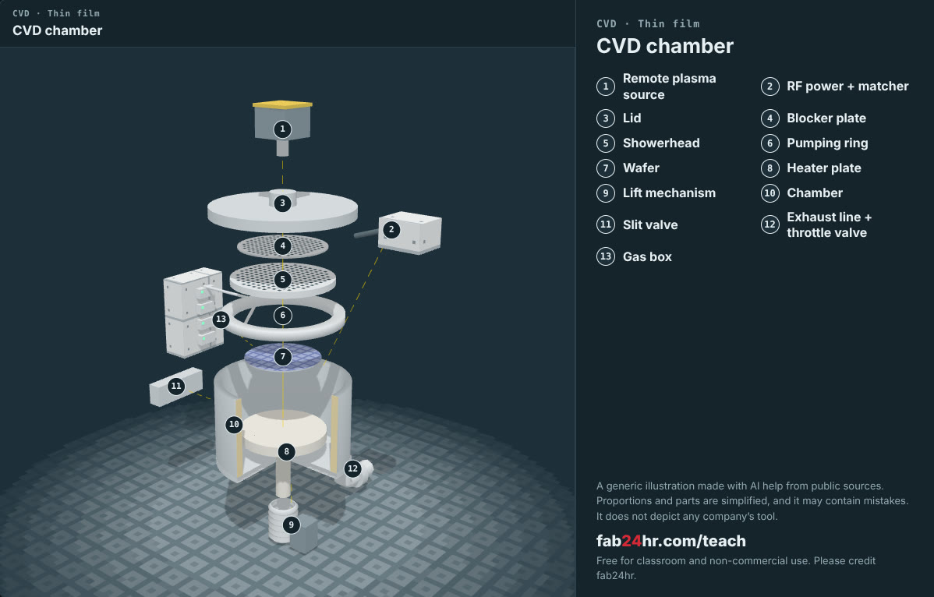
Semiconductors 101, unit 10 · Look: machines to take apart
fab24hr.com/en/learn/thin-film/
fab24hr
Notes:
CVD chamber：https://fab24hr.com/en/?tool=cvd

Slide 17
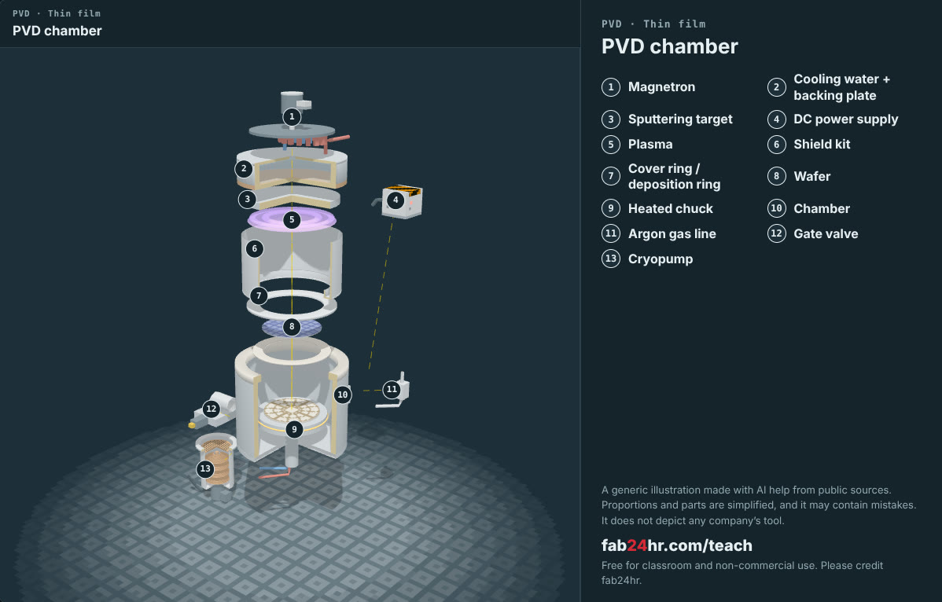
Semiconductors 101, unit 10 · Look: machines to take apart
fab24hr.com/en/learn/thin-film/
fab24hr
Notes:
PVD chamber：https://fab24hr.com/en/?tool=pvd

Slide 18

Semiconductors 101, unit 10
Play
Play a shift as a thin-film process engineer: look after every film your sputtering tool lays down
Scan with a phone to play from here
fab24hr.com/en/?job=pfi&utm_source=slides
fab24hr.com/en/learn/thin-film/
fab24hr

Slide 19
Semiconductors 101, unit 10
Think
1 Which do you think is harder to control, how thick a film is or how even it is? If it is thicker in the middle than at the edge, what problems might later steps run into?
2 A film a little thicker or thinner changes what comes out of CMP, the next step. If you were the thin-film engineer, what would you tell the next step before they ask, and why?
fab24hr.com/en/learn/thin-film/
fab24hr

Slide 20
Semiconductors 101, unit 10
Read
What is thin film deposition? How chips are built up layer by layer
fab24hr.com/en/blog/what-is-thin-film/
What is epitaxy? How a perfectly ordered layer of silicon grows on a wafer
fab24hr.com/en/blog/what-is-epitaxy/
Further
Why do semiconductor tools need a vacuum?
fab24hr.com/en/learn/thin-film/
fab24hr

Slide 21
Semiconductors 101, unit 10
Semiconductors 101: a free course following the life of a chip
https://fab24hr.com/en/learn/thin-film/
Written from public textbooks, industry standards, university course notes and papers; the companies, people, machine numbers and figures in the game are fictional.
Free to use in class and for non-commercial teaching. Please credit fab24hr. Do not sell it or present it as your own work.
Generic illustration made with AI help from public sources; may contain mistakes; not any company’s tool
fab24hr.com/en/learn/thin-film/
fab24hr

