Slide 1
Semiconductors 101, unit 6
Wafers and cleanrooms
Chips are made on a round silicon wafer, inside a very clean cleanroom. Why round? Why ever larger? And how clean is clean enough?
Semiconductors 101: a free course following the life of a chip
Free to use in class and for non-commercial teaching. Please credit fab24hr. Do not sell it or present it as your own work.
fab24hr.com/en/learn/wafer-cleanroom/
fab24hr
Notes:
Chips are made on a round silicon wafer, inside a very clean cleanroom. Why round? Why ever larger? And how clean is clean enough?

Slide 2
Semiconductors 101, unit 6
Goals
1 Explain why wafers are round, what 12-inch and 8-inch mean, and what larger wafers gain.
2 Describe cleanroom classes by the most particles a cubic meter of air may hold, and why a single particle can ruin a chip.
3 Know that a fab also uses large amounts of ultrapure water and special gases, and why they are handled so carefully.
fab24hr.com/en/learn/wafer-cleanroom/
fab24hr

Slide 3
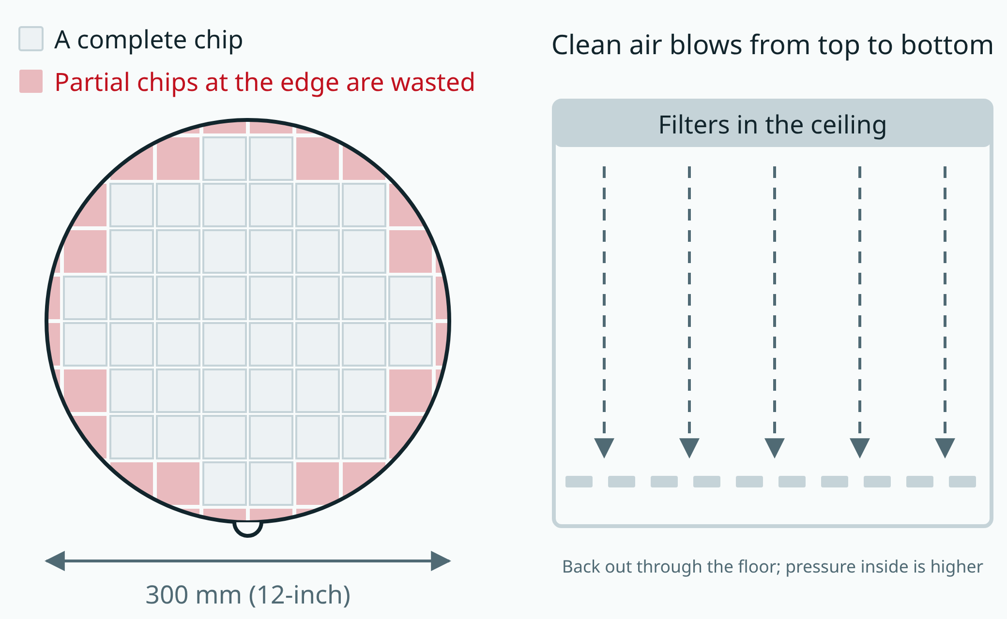
Semiconductors 101, unit 6
The bigger the wafer, the smaller the share lost at the edge. A cleanroom sweeps particles away with clean air flowing downward, and keeps the air pressure inside higher than outside.
fab24hr.com/en/learn/wafer-cleanroom/
fab24hr
Notes:
Left: a round wafer covered in square chips; the chips at the edge that do not fit are wasted. Right: a cleanroom, where filtered air blows down from the ceiling and returns through a floor full of holes.

Slide 4
Semiconductors 101, unit 6 · Step by step 1/2
Step by step
1 Choose silicon, and purify it to an extreme degree.
Why: Silicon is the second most common element in the earth's crust, and at high heat it grows a good insulating layer of its own.
If not: The very first transistors used germanium, which leaks current as it warms up and has an unstable oxide, so silicon replaced it.
2 Melt the silicon, then rotate a seed and pull it up slowly to grow a single-crystal ingot.
Why: Chips need single-crystal silicon with its atoms lined up perfectly, and the melt freezes onto the seed following its pattern.
If not: Since the ingot turns as it grows, it comes out round; grinding it square would turn the costly crystal at the corners into scrap.
3 Slice the ingot and polish the slices into wafers, which have kept growing to today's common 12 inches (300 mm).
Why: 1.5 times the diameter gives about 2.25 times the area, while tools, people, power and water don't grow nearly as much.
If not: On a small wafer each chip carries more of the cost, and the incomplete chips around the edge waste a bigger share.
fab24hr.com/en/learn/wafer-cleanroom/
fab24hr

Slide 5
Semiconductors 101, unit 6 · Step by step 2/2
Step by step
4 Work in a cleanroom, whose ISO class caps the particles in each cubic meter of air.
Why: A 0.5-micrometer particle is more than ten times the spacing between the densest lines on the most advanced chips.
If not: One landing on a wafer is like a boulder on the circuit: a line breaks or two lines join, and that chip is dead.
5 Blow filtered air down from the ceiling, and keep the room's pressure slightly above the outside.
Why: Particles from people and tools are carried down to the floor, and when a door opens, air flows out.
If not: Particles would drift in the air and sideways onto wafers, and dust from outside would get in more easily.
6 Cover people head to toe in cleanroom suits, put on from the top down, then send them through an air shower (strong air that blows particles off the suit).
Why: People keep shedding skin flakes, hair and fibers, and are the biggest source of particles in a cleanroom.
If not: Uncovered, all of it goes into the room: a figure often quoted is over 100,000 particles a minute from one person standing still, and a million or more while walking.
fab24hr.com/en/learn/wafer-cleanroom/
fab24hr

Slide 6
Semiconductors 101, unit 6 · Key ideas 1/4
Wafers are round because silicon grows as a cylinder
Chips need single-crystal silicon, with its atoms lined up perfectly. The most common way to make it is to melt very pure silicon, touch the surface with a small piece of single-crystal silicon as a seed, and pull it upward very slowly while rotating it. A long, round crystal called an ingot grows. Sliced thin and polished mirror-flat, it becomes a wafer, less than a millimeter thick. From materials to tools to the boxes wafers travel in, the whole industry is built around round wafers.
fab24hr.com/en/learn/wafer-cleanroom/
fab24hr

Slide 7
Semiconductors 101, unit 6 · Key ideas 2/4
Bigger wafers spread the cost
"12-inch" and "8-inch" name a wafer's diameter, which is actually specified as 300 mm and 200 mm; "inch" is just the name that stuck. The diameter is 1.5 times as large, but chips cover the whole surface, so the area is 1.5 times 1.5, about 2.25 times. Many steps handle one wafer or one batch at a time, so a bigger wafer means more chips each time, while the tools, people, power and water don't grow 2.25 times. Spread over each chip, the cost can come down.
fab24hr.com/en/learn/wafer-cleanroom/
fab24hr

Slide 8
Semiconductors 101, unit 6 · Key ideas 3/4
Cleanrooms count particles, and one can kill a chip
A cleanroom's class is set by how many particles above a given size one cubic meter of air may hold. The "Class 100" people often mention comes from an older US standard and is roughly ISO 5 in today's international standard: at most 3,520 particles of 0.5 micrometers or larger, where city air outdoors often holds tens of millions. A micrometer is a thousandth of a millimeter, so a 0.5-micrometer particle is about a hundred times smaller than a hair is wide, yet more than ten times the spacing between the densest lines on the most advanced chips. Landing on a wafer, it's like a boulder dropped on the circuit: it can break a line or join two lines, and that chip is dead. So advanced fabs count particles of 0.1 micrometer and smaller too.
fab24hr.com/en/learn/wafer-cleanroom/
fab24hr

Slide 9
Semiconductors 101, unit 6 · Key ideas 4/4
Water and gases must be extremely pure too
After every chemical bath, a wafer is rinsed with ultrapure water: water with ions, particles, organic matter and more taken out almost completely. It's the last liquid to touch the wafer surface, so whatever is in it can stay on the wafer. Chips are cleaned many times, so an advanced fab uses several million gallons of it a day. Many steps also happen in gas, and some specialty gases are toxic, corrosive or flammable, so the protection comes in layers: equipment to contain them, detectors to sniff for them, and procedures on top, never anyone's nose.
fab24hr.com/en/learn/wafer-cleanroom/
fab24hr

Slide 10
Semiconductors 101, unit 6
Common misconceptions
People say: Chips are square, so square wafers would waste less.
In fact: Silicon grows as a cylinder, and grinding it square would throw away all the expensive single-crystal silicon outside the corners. Photoresist, a light-sensitive coating, is spread by spinning the wafer fast, and a circle has no corners to chip. Chips that don't fit whole at the round edge are wasted, and that is one reason wafers grew bigger: the bigger the wafer, the smaller the share the edge takes up.
People say: Cleanroom suits are there to protect the people wearing them.
In fact: They mainly protect the wafers. People keep shedding skin flakes, hair, fibers and tiny droplets, and they are the biggest source of particles in a cleanroom. A suit cuts this down a lot but not to zero, so people inside move slowly, and wafers travel in sealed boxes as much as possible. Still, wafers spend most of their time sealed in pods and tools, so today most defects on a wafer come from the tools and processes themselves; that is why every tool regularly runs a monitor wafer to count the particles it adds.
fab24hr.com/en/learn/wafer-cleanroom/
fab24hr

Slide 11
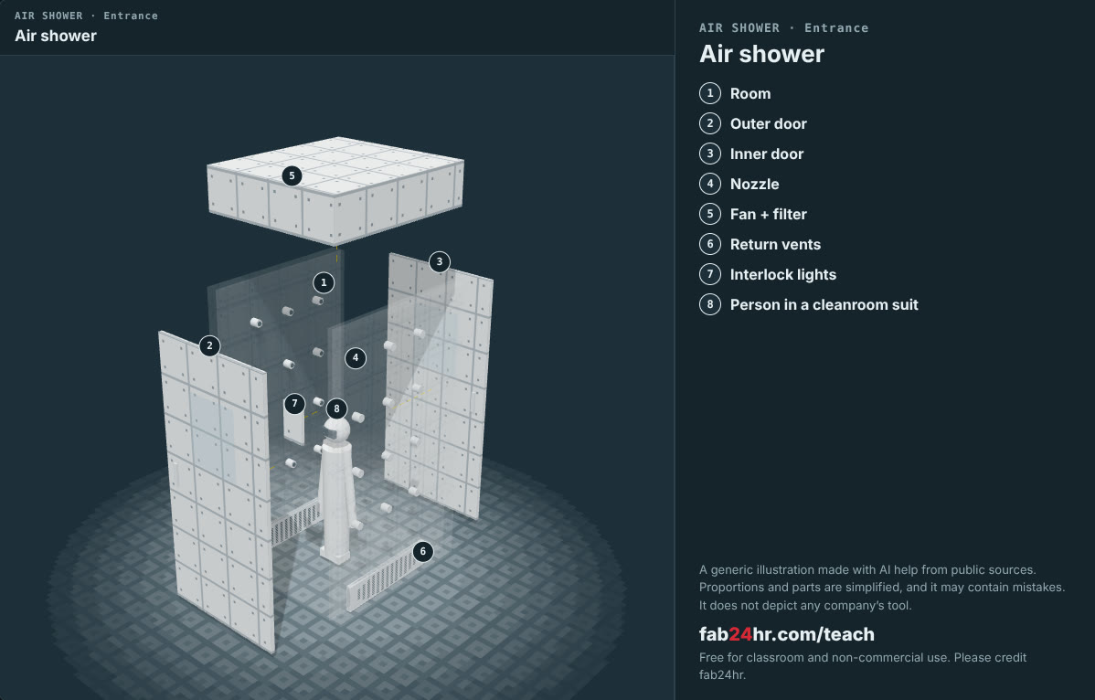
Semiconductors 101, unit 6 · Look: machines to take apart
fab24hr.com/en/learn/wafer-cleanroom/
fab24hr
Notes:
Air shower：https://fab24hr.com/en/?tool=shower

Slide 12
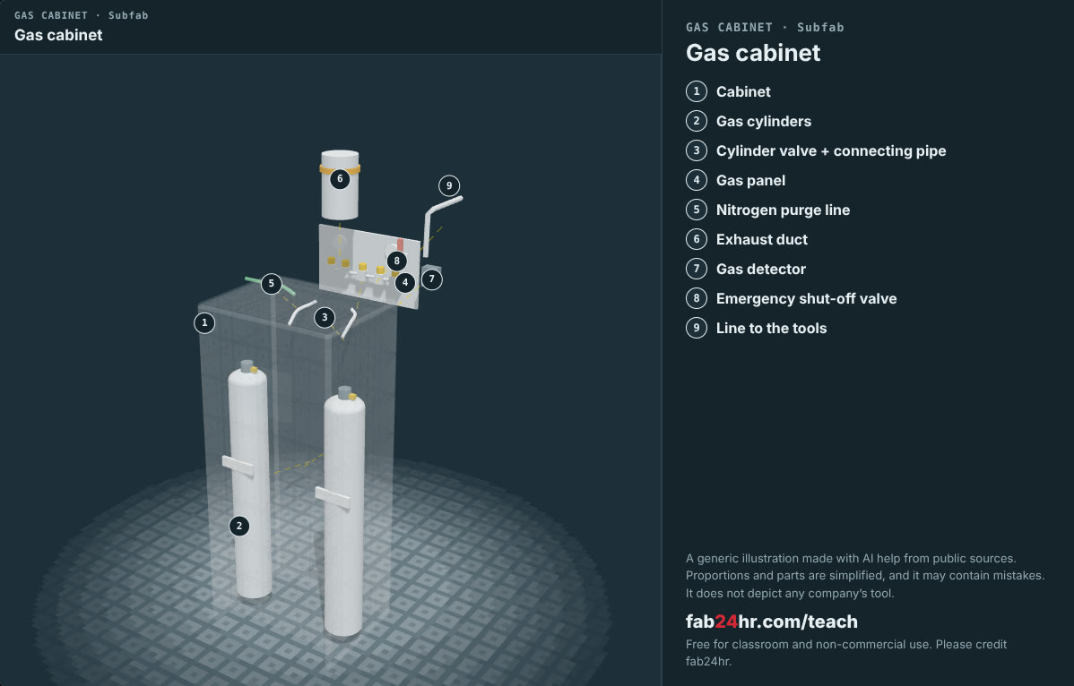
Semiconductors 101, unit 6 · Look: machines to take apart
fab24hr.com/en/learn/wafer-cleanroom/
fab24hr
Notes:
Gas cabinet：https://fab24hr.com/en/?tool=gascab

Slide 13

Semiconductors 101, unit 6
Play
Play a shift as a facilities engineer: water, power, air and gases
Scan with a phone to play from here
fab24hr.com/en/?job=fac&utm_source=slides
fab24hr.com/en/learn/wafer-cleanroom/
fab24hr

Slide 14
Semiconductors 101, unit 6
Think
1 A fab uses a lot of water and electricity, and it matters to the economy. If you lived near one, what would you care about? What would you ask the company to explain?
2 In a cleanroom, people are the biggest source of particles. If you wrote the rules for going in and out, which three rules would you set, and why?
fab24hr.com/en/learn/wafer-cleanroom/
fab24hr

Slide 15
Semiconductors 101, unit 6
Read
Why are wafers round?
fab24hr.com/en/blog/why-wafers-round/
What do 12-inch and 8-inch wafers mean, and why did wafers get bigger?
fab24hr.com/en/blog/wafer-sizes/
How clean is a cleanroom? What Class 100 and ISO 5 mean
fab24hr.com/en/blog/cleanroom-class/
Further
What is a bunny suit, and why do chip fab workers wear one?
How pure is ultrapure water, and why do chip fabs use so much of it?
What gases does a chip fab use, and why so much care?
Why do semiconductor fabs use so much electricity?
fab24hr.com/en/learn/wafer-cleanroom/
fab24hr

Slide 16
Semiconductors 101, unit 6
Semiconductors 101: a free course following the life of a chip
https://fab24hr.com/en/learn/wafer-cleanroom/
Written from public textbooks, industry standards, university course notes and papers; the companies, people, machine numbers and figures in the game are fictional.
Free to use in class and for non-commercial teaching. Please credit fab24hr. Do not sell it or present it as your own work.
Generic illustration made with AI help from public sources; may contain mistakes; not any company’s tool
fab24hr.com/en/learn/wafer-cleanroom/
fab24hr

